Slide 1

C++ Saturation Arithmetic
Lloyd Moore, President
Lloyd@CyberData-Robotics.com
www.CyberData-Robotics.com

Slide 2
Agenda:
What is saturation arithmetic?
Why would you use it?
Compiler availability
Library calls
Implementation and efficiency
Alternatives

Slide 3
What is Saturation Arithmetic?
Saturation arithmetic is a mode of numerical computation where the results of arithmetic operations are clipped (or “saturated”) to lie within the allowable representational limits of the data type rather than wrapping around or producing undefined values when an overflow would otherwise occur.
If the value is greater than the maximum value for the given data type, use the maximum value.
If the value is less than the minimum value for the given data type, use the minimum value.

Slide 4
Why Would You Use It?
Results are guaranteed to “fit” into the the resulting data type
Accuracy and range will be compromised
Avoids undefined, wraparound or “modulo” results
Some domains have “natural” limits that can be directly represented:
RGB values are naturally 0-255
Audio values are naturally 16 to 24 bits
Real world sensors “saturate” at their limits
Ok maybe not ideal but models what the sensor does

Slide 5
Availability
Saturation Arithmetic is targeting C++26, however it is available NOW in some compilers:
GCC 14.1
Verified on GodBolt for x86-64 & ARM
Clang 19.1.0
Verified on GodBolt for x86-64 & ARM
Apple Clang 16.0.0
From: CppReference:
https://en.cppreference.com/w/cpp/compiler_support/26.html
Standards Paper: P0543R3:
https://www.open-std.org/jtc1/sc22/wg21/docs/papers/2023/p0543r3.html

Slide 6
Compiler Flags
Need to set compiler flags to use this feature:
GCC 14.1: -std=c++26 -O3
Clang 19.1.0: -std=c++26 -O3
Of course -O3 is optional, but we’ll be using this setting later when we look at the optimized assembly code.

Slide 7
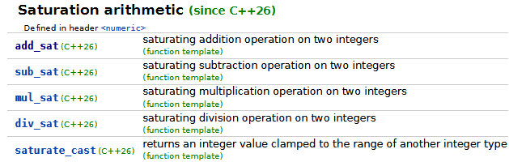
Library Calls
Note: The operations are not defined on the integral types: bool, char, wchar_t, char_16_t and char32_t, as these are not intended for arithmetic. (Per: P0543R3)
From: cppreference.com

Slide 8
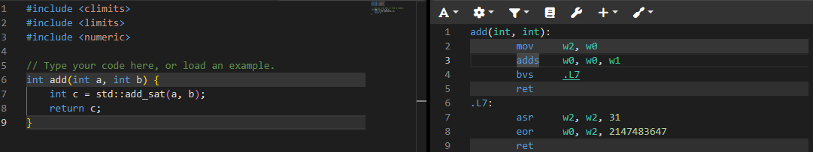
Add Implementation:
GCC, AARCH64
Observations:
Performs the addition, tests for overflow and forms a constant return value if needed.
From: godbolt.com

Slide 9
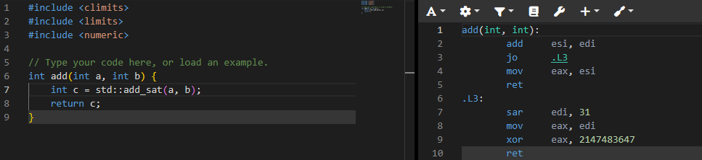
Add Implementation:
GCC, x86-64
Observations:
Pretty similar to the ARM result, but a few more instructions.
From: godbolt.com

Slide 10
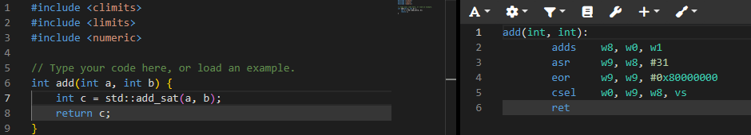
Add Implementation:
Clang, AARCH64
Observations:
Performs the addition, unconditionally loads a constant, and THEN selects which one to return.
Note the lack of a branch!
From: godbolt.com

Slide 11
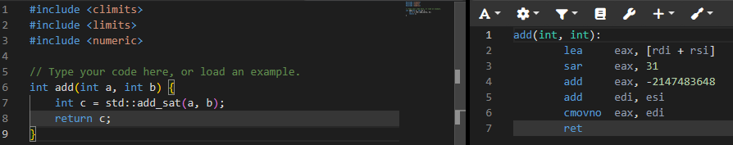
Add Implementation:
Clang, x86-64
Observations:
Sets up a constant to return, then does the add, and conditionally returns the correct value.
Note the lack of a branch!
From: godbolt.com

Slide 12
Implementation: Subtraction & Multiplication
The subtraction and multiplication operations follow the same general pattern for each of the operations in each of the compiler and processor contexts.
Some are are slightly more complex, but only by an instruction or two.
From: godbolt.com

Slide 13
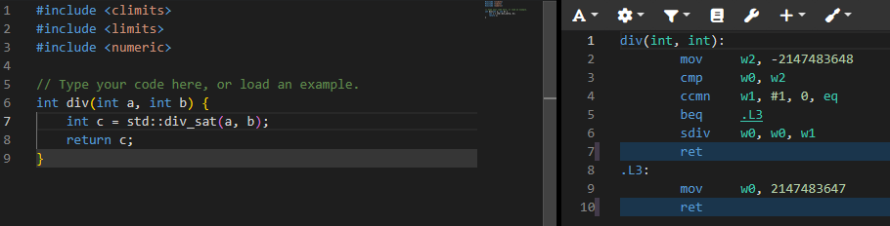
Div Implementation:
GCC, AARCH64
Observations:
Tests the inputs and then returns either a constant or the divided value as needed.
From: godbolt.com

Slide 14
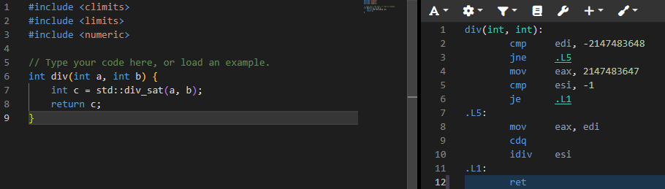
Div Implementation:
GCC, x86-64
Observations:
Tests the inputs and then returns either a constant or the divided value as needed.
From: godbolt.com

Slide 15
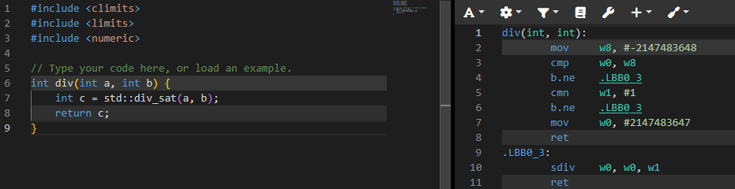
Div Implementation:
CLang, AARCH64
Observations:
Tests the inputs and then returns either a constant or the divided value as needed.
From: godbolt.com

Slide 16
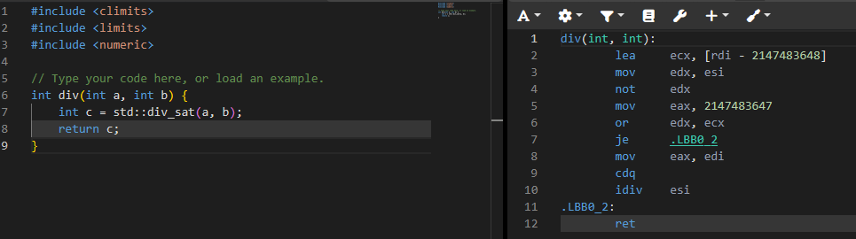
Div Implementation:
CLang, x86-64
Observations:
Tests the inputs and then returns either a constant or the divided value as needed.
From: godbolt.com

Slide 17
Alternatives for ARM:
Assembly Code:
The NEON instruction set supports the ‘Q’ modifier for saturation arithmetic: https://developer.arm.com/documentation/den0018/a/NEON-Instruction-Set-Architecture/Instruction-syntax/Instruction-modifiers?lang=en
From: godbolt.com

Slide 18
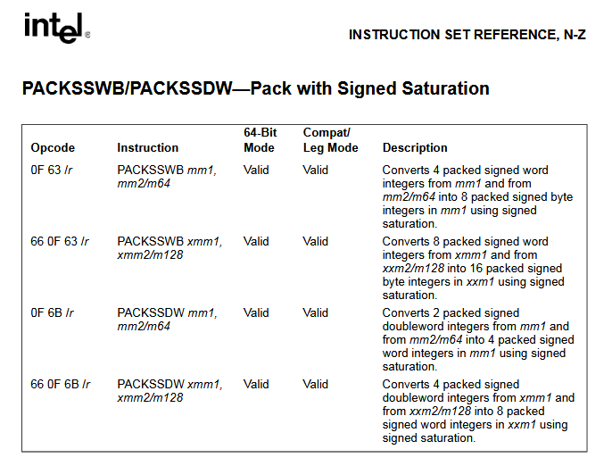
Alternatives for X86-64:
Assembly Code:
The MMX/SSE instruction set supports the “packed unsigned saturated add” instructions: https://www.scs.stanford.edu/05au-cs240c/lab/ia32/IA32-2B.pdf
From: godbolt.com

Slide 19
Resources
Compiler Explorer Playground:
https://godbolt.org/z/nvevqc3b5
P0543R3: Saturation Arithmetic:
https://www.open-std.org/jtc1/sc22/wg21/docs/papers/2023/p0543r3.html
CppReference.com:
https://en.cppreference.com/w/cpp/numeric.html
C++26 Compiler Support
https://en.cppreference.com/w/cpp/compiler_support/26.html

Slide 20
Questions?

