Slide 1
MicroCode: portable programming for physical computing
https://aka.ms/microcode
Thomas Ball
Microsoft Research
2025

Slide 2
Portable
Programming
Data science
Music, lights
Robots
…
Physical Computing

Slide 3
~
software+hardware that senses
and responds to the real world
Physical Computing
https://www.microsoft.com/en-us/research/uploads/prod/2020/04/physical-computing.pdf

Slide 4
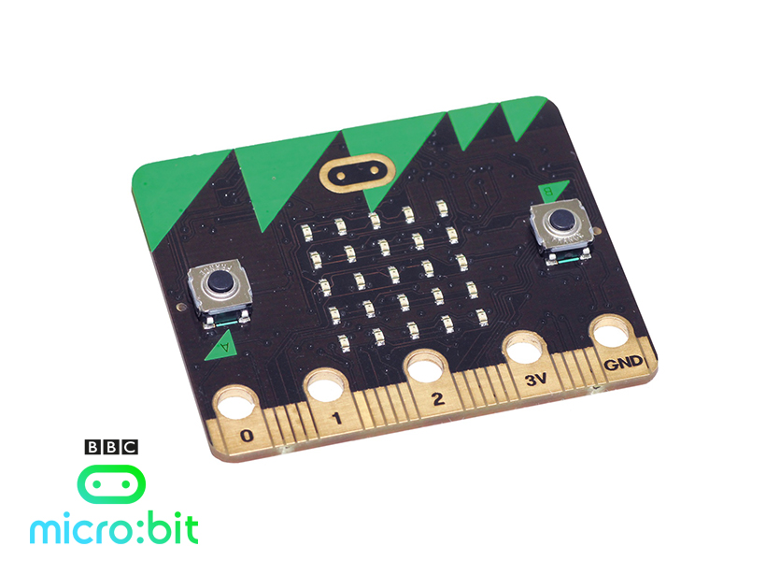
2016
25 LED matrix screen
Light sensor
User definable buttons
17 Digital input/output
6 Analog input
3 PWM output
3 Touch sensitive
I2C, SPI, UART
Notes:
Simple
Inexpensive
Accessible
Integrated
Open
Language agnostic
Transparent

Slide 5
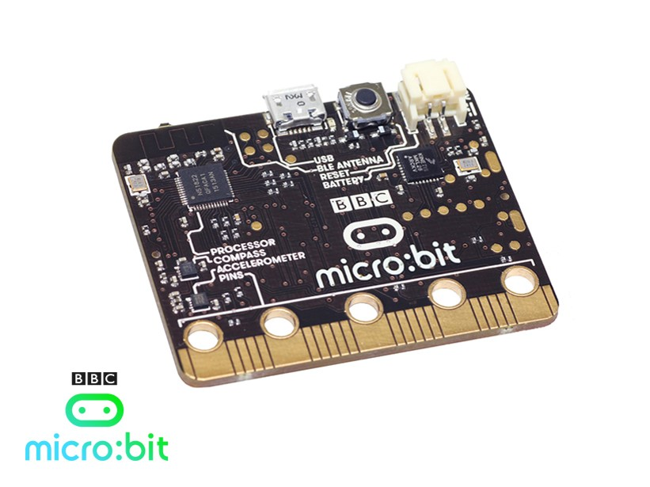
2016
16MHz Cortex M0
16KB RAM, 256K FLASH
AA battery powered
USB Storage/Serial/Debug
3 axis accelerometer
3 axis magnetometer
Temperature sensor
Bluetooth Low Energy

Slide 6
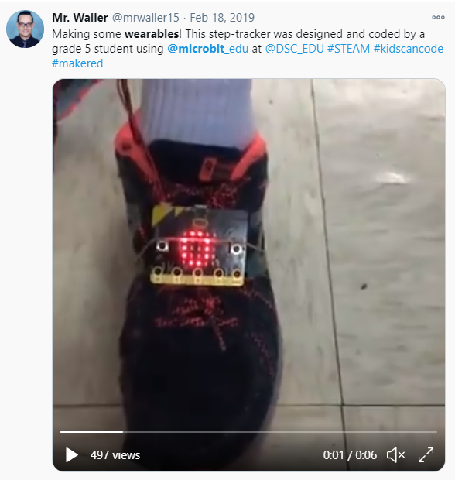
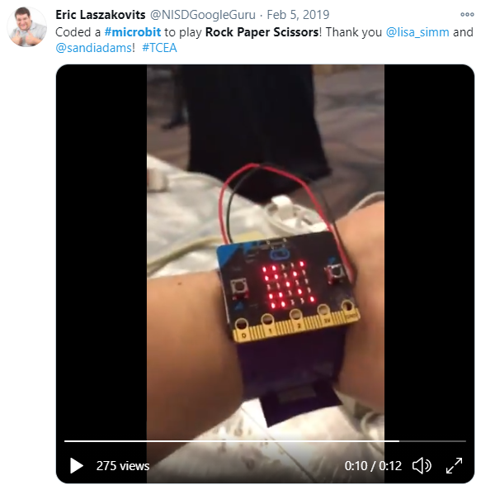

Slide 7
Example Videos (Tom)

Slide 8
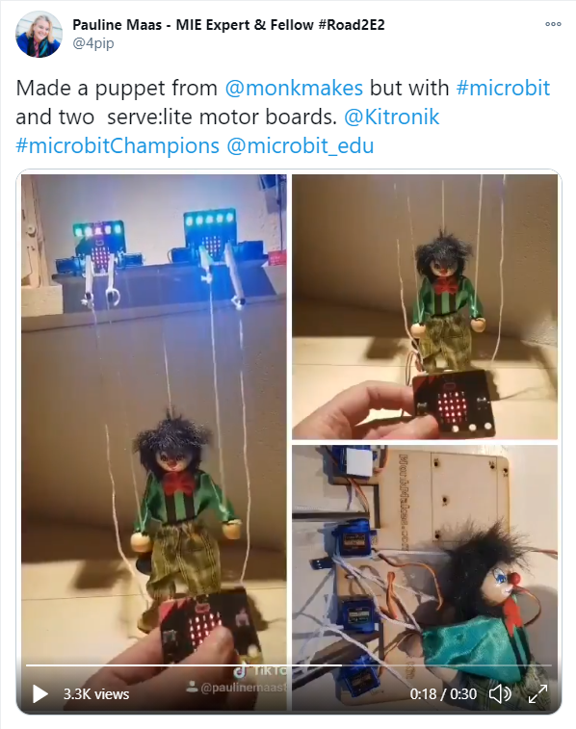
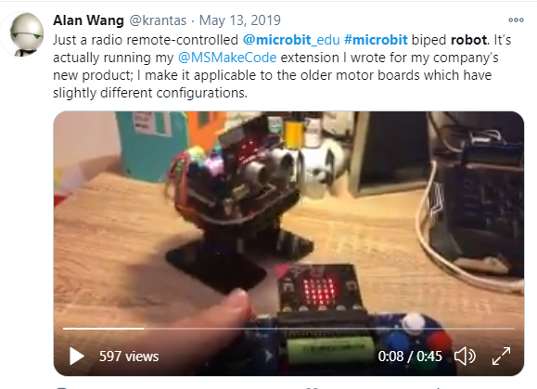
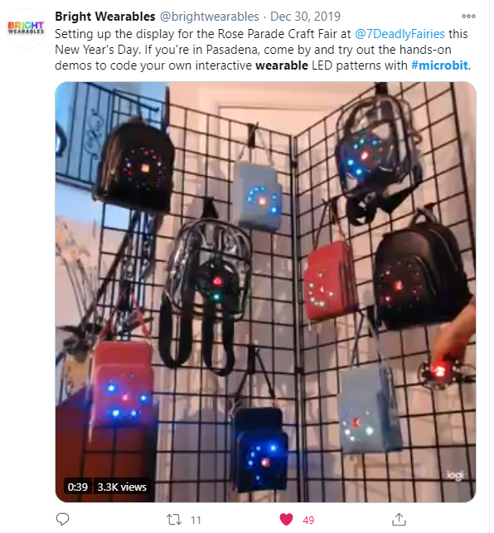

Slide 9
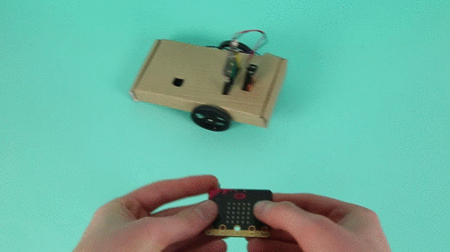

Slide 10
My Personal Interest in Physical Computing
Systems… everywhere!
Digital systems (human designed) and biological systems (evolved)
Motion: 3-axis accelerometer and our vestibular system
Memory: what is it good for? A lot!
Feedback: autonomous nervous system, temperature, homeostasis, …
Incorporation of computers into most of our modern systems
Communication, transportation, economic, …

Slide 11
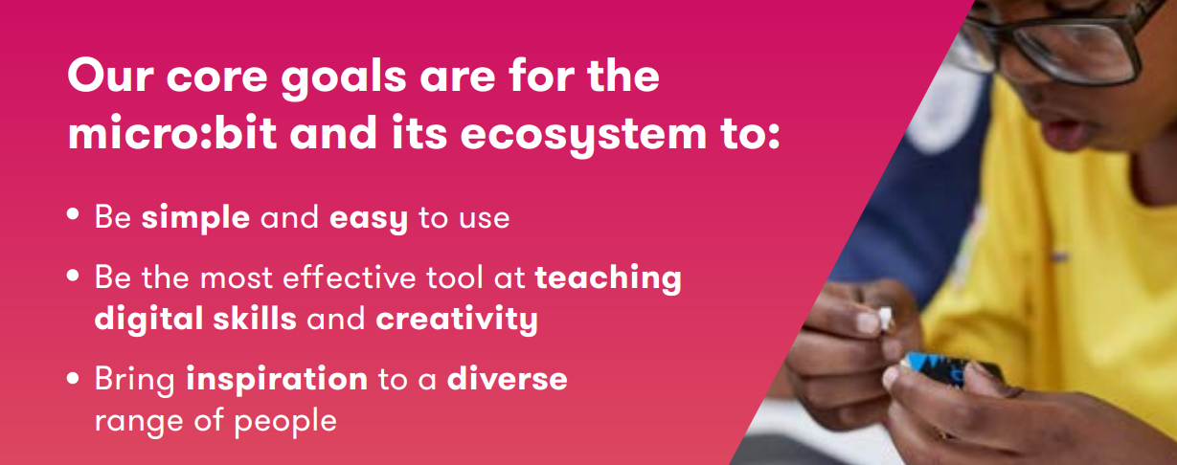
The BBC micro:bit (https://microbit.org)
Notes:
The BBC micro:bit, first released in 2016 in the UK, is a small programmable device with a host of built-in features,

Slide 12
The Micro:bit Educational Foundation, 2016-
https://microbit.org
"inspire every child to create their best digital future“
“[reducing] barriers of access, for children living in different social and economic contexts around the world”
Over 10 million micro:bits distributed to date
primarily to developed countries
main programming environments are web-based

Slide 13
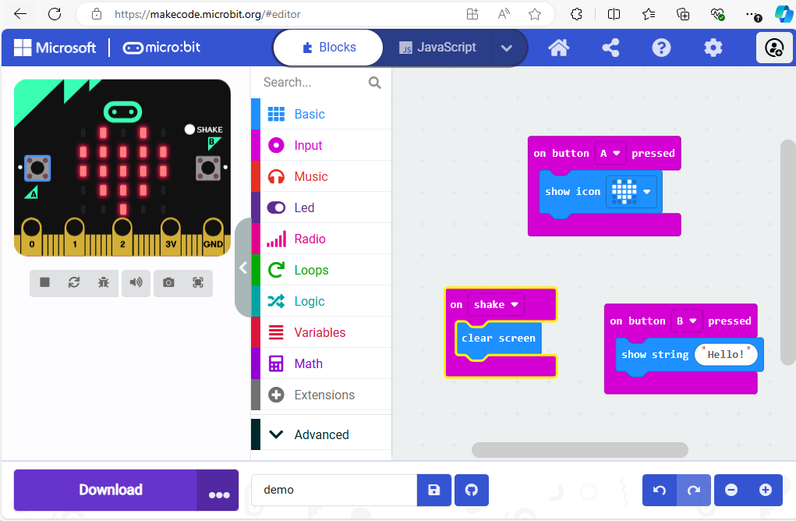

Slide 14
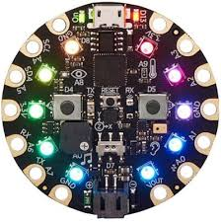
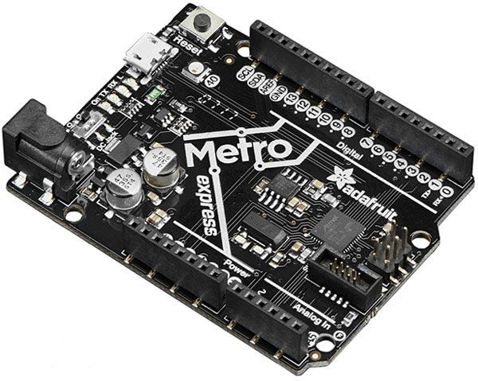
Microsoft MakeCode and CODAL (Lancaster University)
makecode.microbit.org
maker.makecode.com
Web sites
makecode.adafruit.com
Blockly and JavaScript Editors
Static TypeScript
Web app
Simulator
Compiler
CODAL C++ Runtime
Devices
Notes:
Web app is the bridge.

Slide 15
Innovations
Web app for end-to-end experience
in-browser compilation to binary
https://github.com/microsoft/pxt
TypeScript as core language
coverage of OO concepts
https://github.com/microsoft/TypeScript
Runtime abstractions
Events, message bus and co-routines
https://github.com/lancaster-university/codal
File format for flashing over USB
https://github.com/microsoft/uf2
Blockly
Static
TypeScript
C++
Notes:
web based editor: nothing to install
cross platform: works in most modern browsers from tiny phone to giant touch screens
compilation in the browser: the compiler runs in your browser, it's fast and works offline
blocks + JavaScript: drag and drop blocks or type JavaScript, MakeCode let's you go back and forth between the two.
works offline: once you've loaded the editor, it stays cached in your browser.
event based runtime: easily respond to button clicks, shake gestures and more

Slide 16
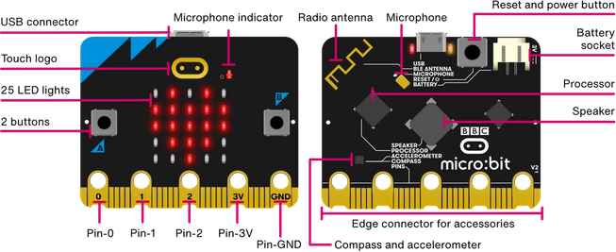
2020: micro:bit V2
Cortex-M4 32-bit processor with FPU
Flash 512KB
RAM 128KB
https://tech.microbit.org/hardware/
Notes:
ModelNordic nRF52833
Core

Slide 17
2020: micro:bit V2
Cortex-M4 32-bit processor with FPU
Flash 512KB
RAM 128KB
https://tech.microbit.org/hardware/
Notes:
ModelNordic nRF52833
Core

Slide 18
MicroCode
Goals:
“[reducing] barriers of access, for children living in different social and economic contexts around the world”
bring BBC micro:bit to those lacking access to laptop/desktop computers, reliable internet, mains power
bring the micro:bit experience to earlier ages
Assumptions, non-assumptions
Literacy (not assumed, should work for pre-literate)
Arithmetic (adding numbers, fingers)

Slide 19
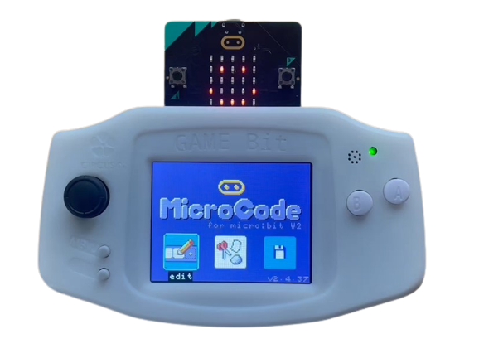
MicroCode: https://aka.ms/microcode
MicroCode portable programming
Leverages four commercially available Arcade shields for the V2
Open source https://github.com/microsoft/microcode

Slide 20
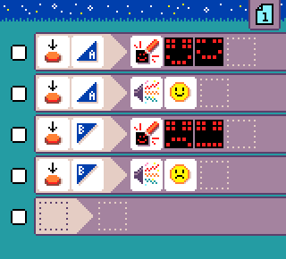
MicroCode Value Proposition
Fun and creative
Simple and live
icons first (text second)
cursor-based navigation
(very) accessible
instant micro:bit update
Extensible via
Jacdac plug-and-play
Remote control robot cars

Slide 21
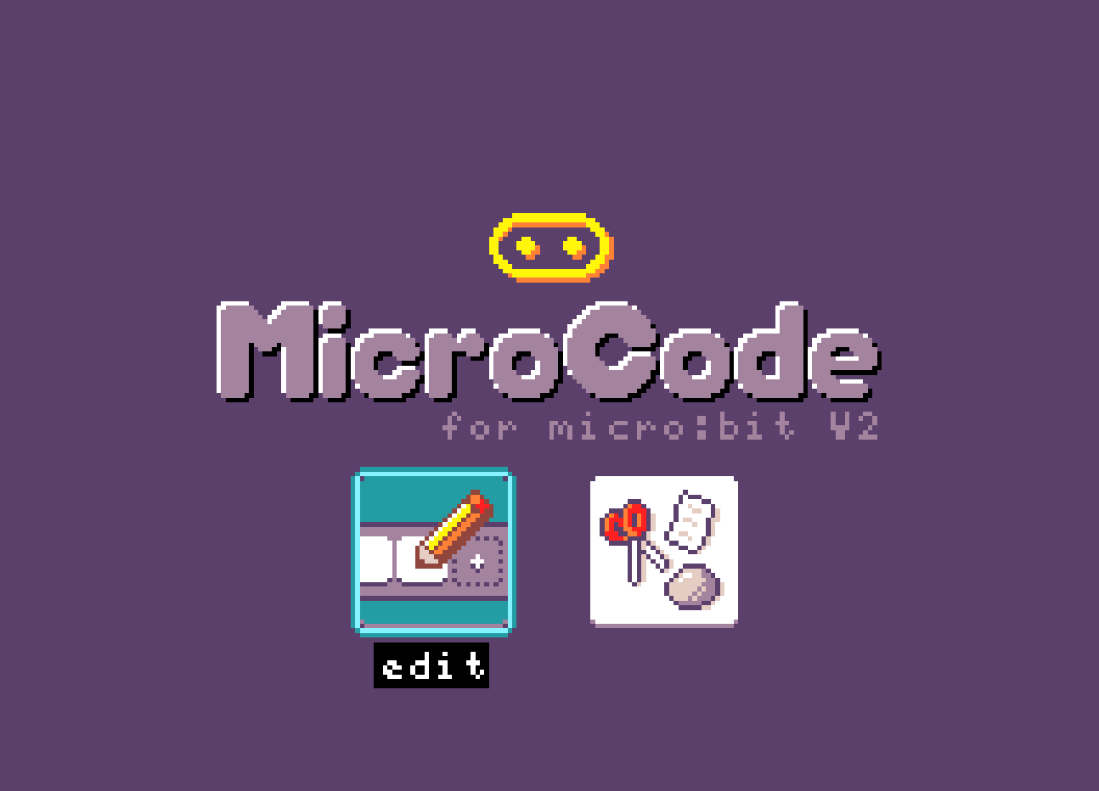
Cursor-based editing
Action | Shield
Move cursor | Direction pad
Select item | A button
Go back | B button

Slide 22
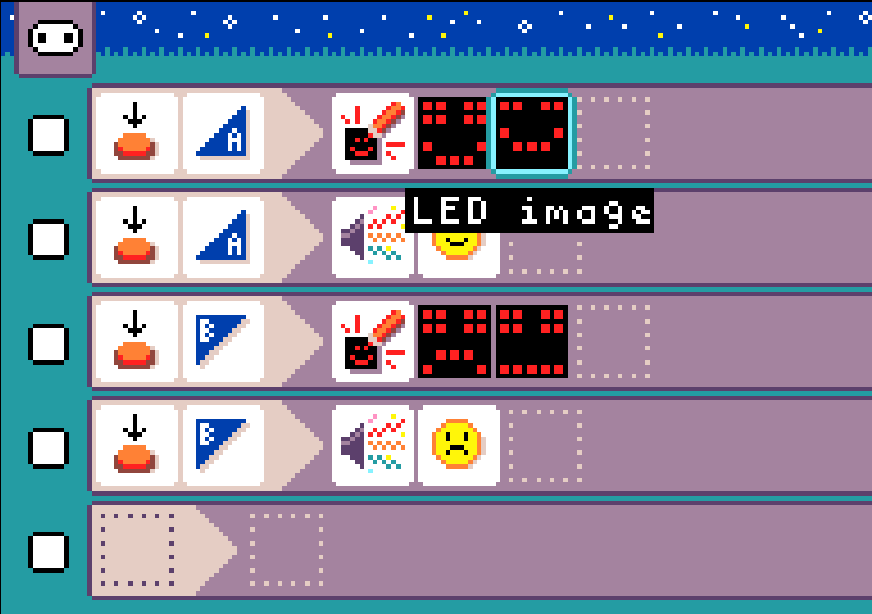
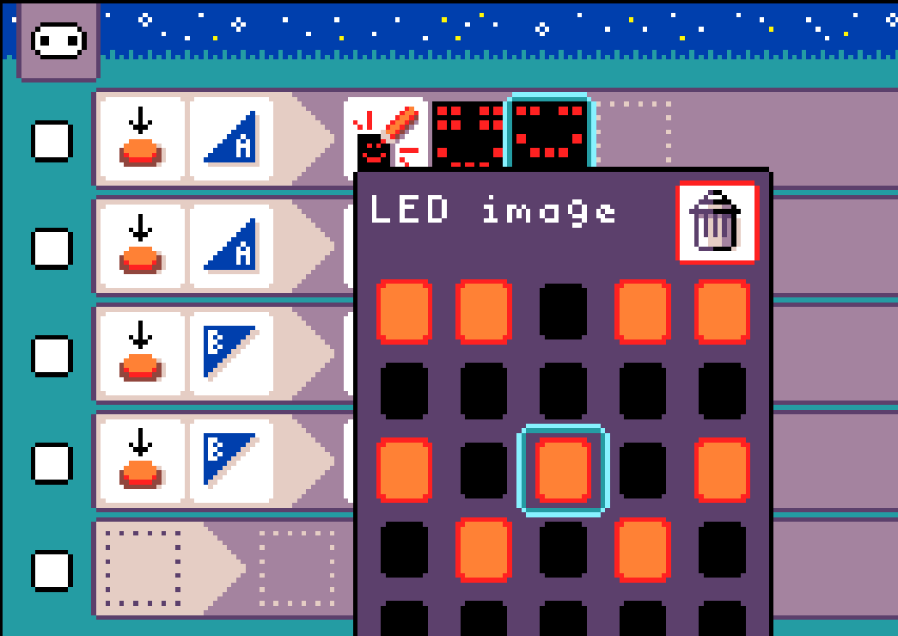
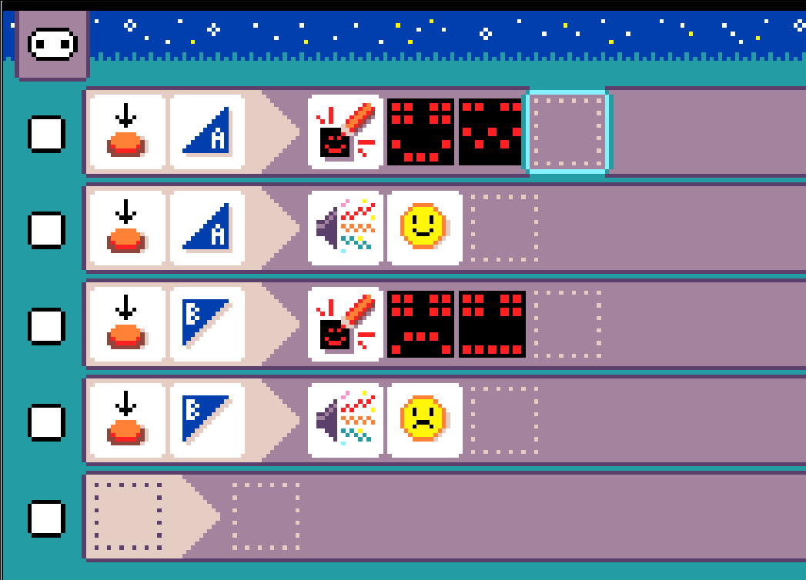
Cursor practice
Move to an LED image and select
Change the LED image
Dismiss LED image editor
Select to toggle LED

Slide 23
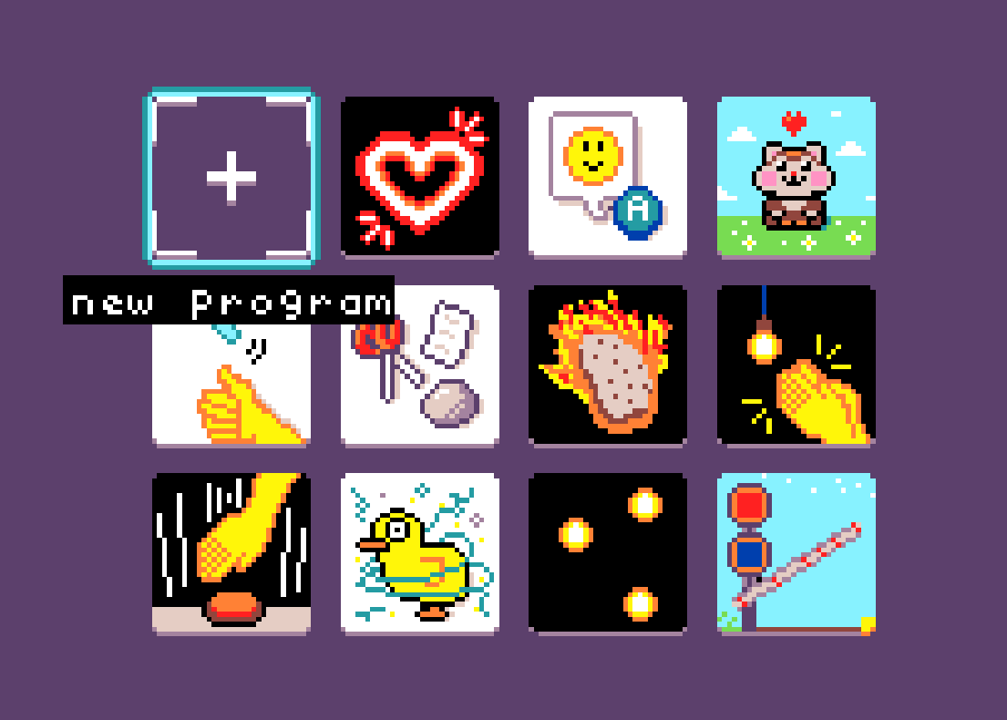
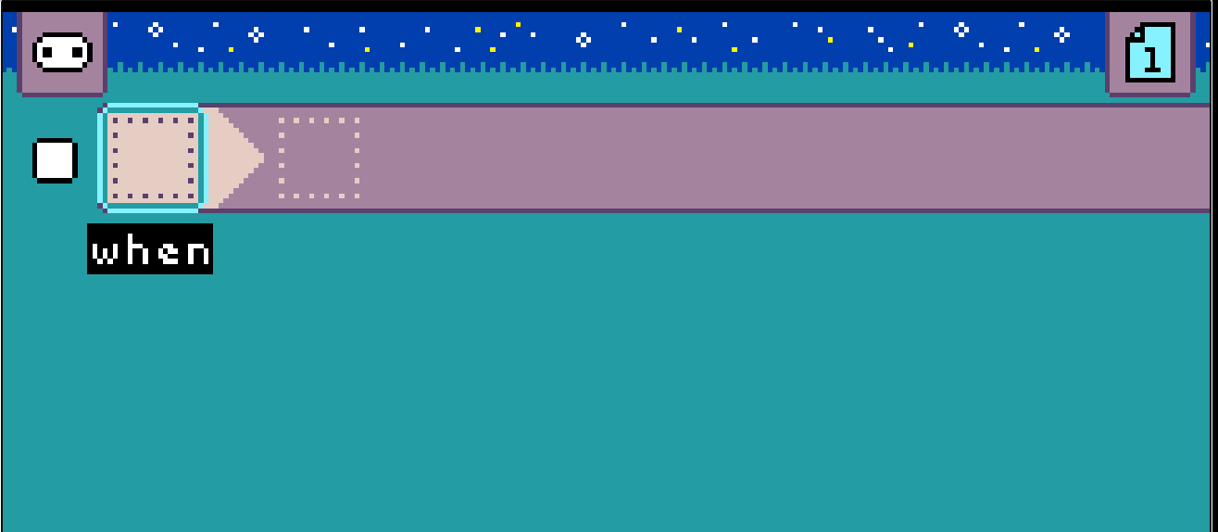
Starting from scratch

Slide 24
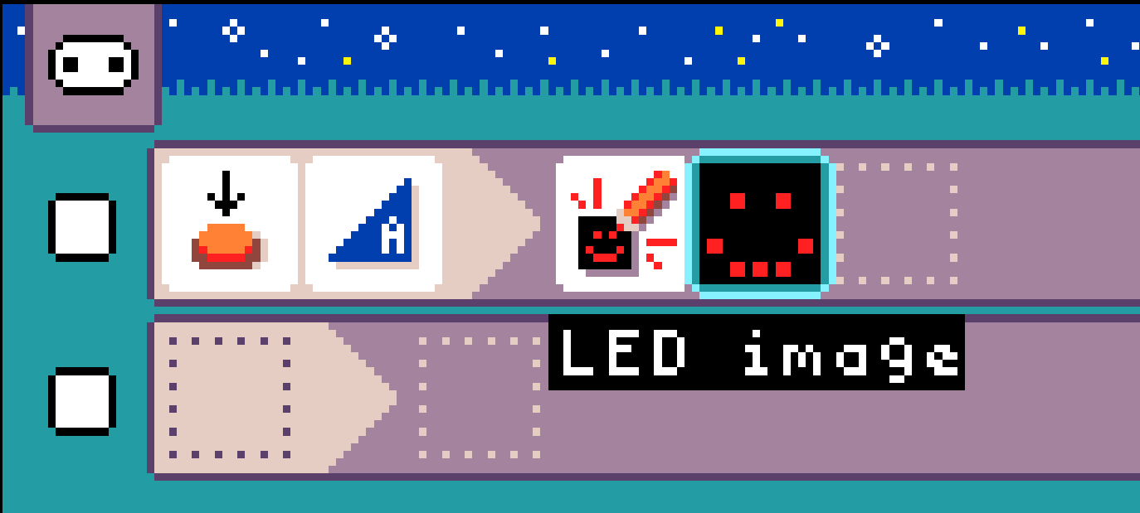
“Space Out”!
Press Space (or A button) to create your first rule…

Slide 25
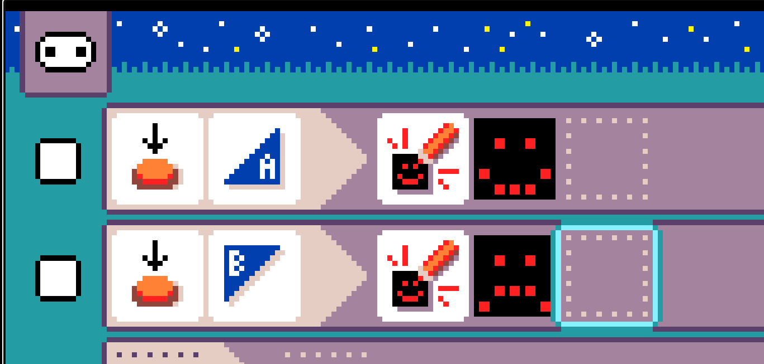
Create second rule for micro:bit B button

Slide 26
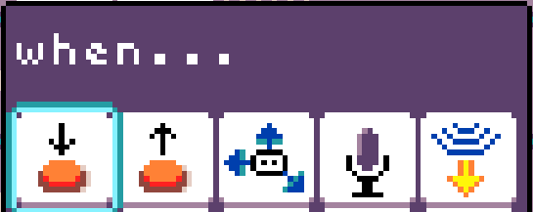
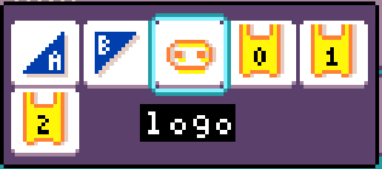
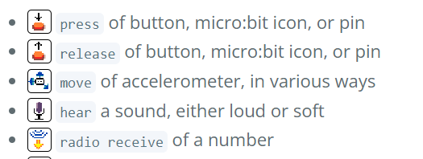
When… there is a micro:bit event …

Slide 27
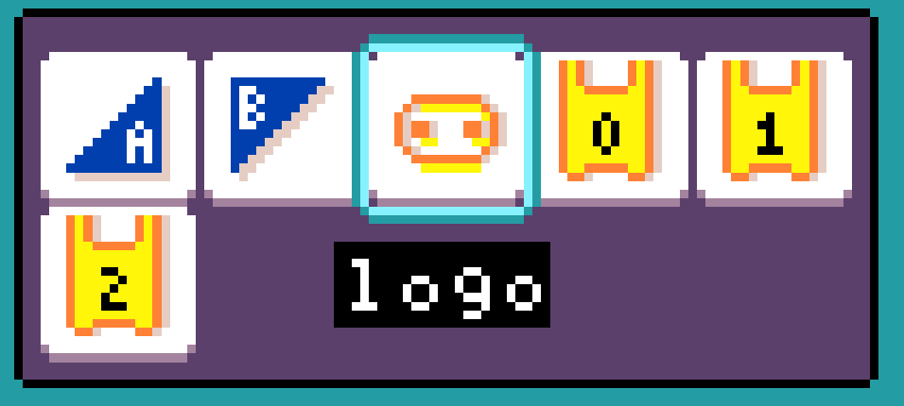
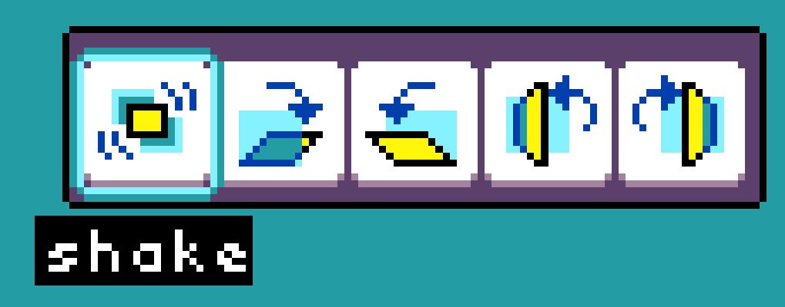
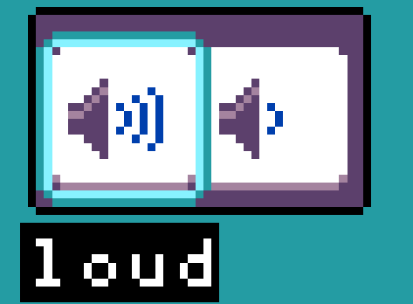

Slide 28
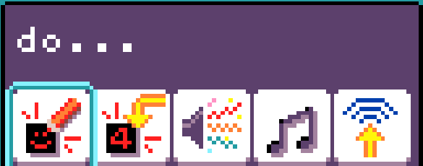
Do… perform a command/action

Slide 29
Experience to date
Meet MicroCode: a Live and Portable Programming Tool for the BBC micro:bit, IDC 2024, https://dl.acm.org/doi/10.1145/3628516.3656995
Reviewed 87 MakeCode quick projects for the micro:bit on https://microbit.org. MicroCode currently can cover
28/43 Beginner projects
11/29 Intermediate projects
5/15 Advanced projects
Teaching with MicroCode (one focused on micro:bit, the other on robots)
Steamlabs (https://steamlabs.ca/) expert brainstorming -> teacher workshop

Slide 30
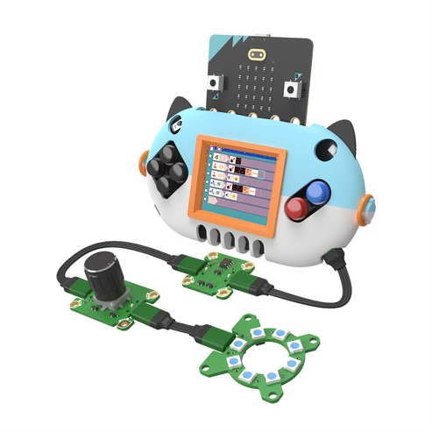
Commercial Availability
https://microsoft.github.io/microcode/docs/purchase
https://www.kittenbot.cc/products/kittenbot-microcode-explorer-kit-computer-free-programming

