Slide 1
Project Everest EverCrypt: A Fast, Verified, Cross-Platform Cryptographic Provider
*the Everest VERified End-to-end Secure Transport
Karthikeyan Bhargavan, Benjamin Beurdouche, Joonwon Choi, Antoine Delignat-Lavaud, Cédric Fournet, Aymeric Fromherz, Chris Hawblitzel, Bryan Parno, Marina Polubelova, Jonathan Protzenko, Tahina Ramananandro, Aseem Rastogi, Nikhil Swamy, Christoph Wintersteiger, Santiago Zanella-Beguelin
Notes:
MSR Cambridge Technical Advisory Board, May 24.
miTLS: our main verified-cryptograph project since 2013; papers, research prototypes, etc.
Everest: a new, more ambitious 5-year research project, just starting.

Slide 2
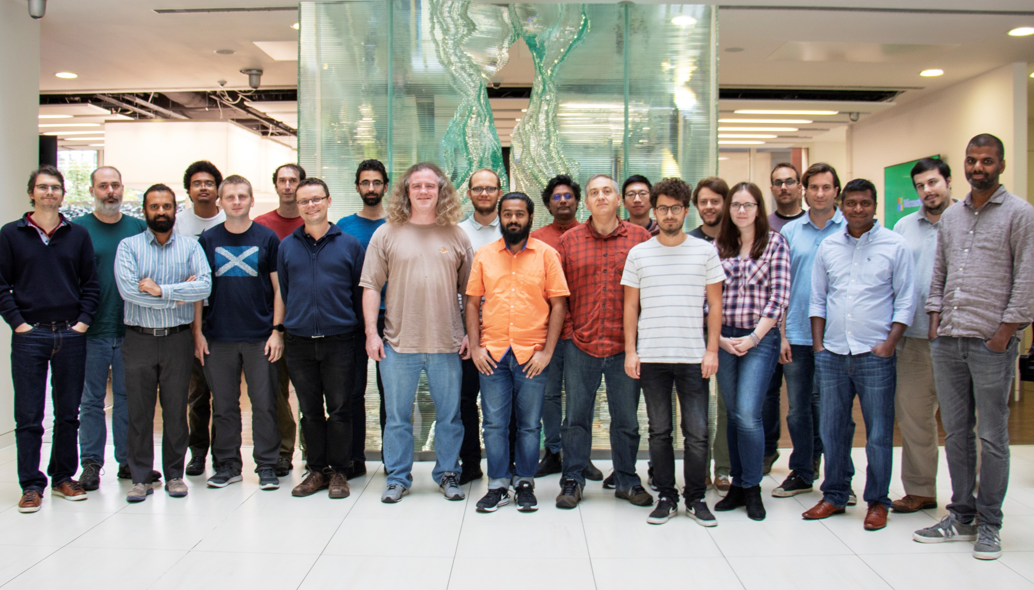
MSR Redmond
Barry Bond
Chris Hawblitzel
Qunyan Magnus
Kiran Muthabatulla
Jonathan Protzenko
Tahina Ramananandro
Nikhil Swamy
Gustavo Varo
MSR Cambridge
Antoine Delignat-Lavaud
Cédric Fournet
Christoph M. Wintersteiger
Santiago Zanella-Béguelin
MSR India
Aseem Rastogi
INRIA Paris
Danel Ahman
Kenji Maillard
Benjamin Beurdouche
Karthikeyan Bhargavan
Victor Dumitrescu
Cătălin Hriţcu
Marina Polubelova
CMU (Pittsburgh)
Jay Bosamiya
Aymeric Fromherz
Bryan Parno
Edinburgh
Markulf Kohlweiss
Interns, open-source contributors, visitors, alumns
Guido Martinez
Zoe Paraskevopoulou
Yao Li
Joonwon Choi
Clément Pit-Claudel
Nick Giannarakis
Niklas Grimm
Anita Gollamudi
Nadim Kobeissi
Matteo Maffei
Asher Manning
Monal Narasimhamurthy
Gordon Plotkin
Perry Wang
Jean-Karim Zinzindohoue
2016 -- present

Slide 3
Everest and EverCrypt

Slide 4
The HTTPS Ecosystem is critical
Services & Applications
Edge
cURL
WebKit
Skype
IIS
Apache
Nginx
Clients
Servers
HTTPS Ecosystem
Most widely deployed security? ½ Internet traffic (+40%/year)
Web, cloud, email, VoIP, 802.1x, VPNs, …
Notes:
HTTPS foundation of Internet Security, from mobile users to cloud services.
Encryption will be mandatory with HTTP/2.
Critical infrastructure for Microsoft (and many others).
Security best practices say don’t invent your own, so everyone uses tools like HTTPS.

Slide 5
The HTTPS Ecosystem is complex
Services & Applications
Edge
cURL
WebKit
Skype
IIS
Apache
Nginx
Clients
Servers
HTTPS
Certification Authority
X.509
ASN.1
TLS
***
RSA
SHA
ECDH
4Q
Crypto Algorithms
Network buffers
Untrusted network (TCP, UDP, …)
Notes:
Distributed system, networking, cryptography.
Complex, but not necessarily large.
Smaller than a browser or an OS, for example.
Amenable to formal verification.

Slide 6
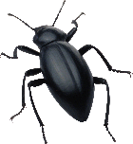
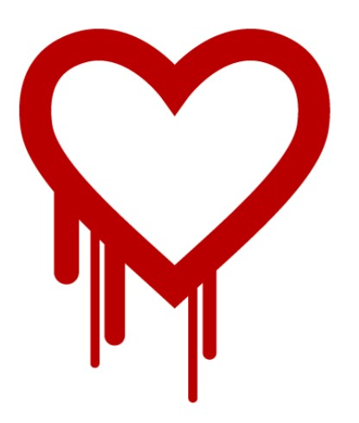
The HTTPS Ecosystem is broken
20 years of attacks & fixes Buffer overflows Incorrect state machines Lax certificate parsing Weak or poorly implemented crypto Side channels
Informal security goals Dangerous APIs Flawed standards
Mainstream implementations OpenSSL, SChannel, NSS, … Still patched every month!
Services & Applications
Edge
cURL
WebKit
Skype
IIS
Apache
Nginx
Clients
Servers
HTTPS
Certification Authority
X.509
ASN.1
TLS
***
RSA
SHA
ECDH
4Q
Crypto Algorithms
Network buffers
Untrusted network (TCP, UDP, …)
Notes:
Many attacks and fixes.
More fundamental problems.
For example, the security goals are informal, revised after some attacks.
The APIs are hard to use securely—many misconfigured clients and servers.
And we found flaws in the standards too, not just their implementations.

Slide 7
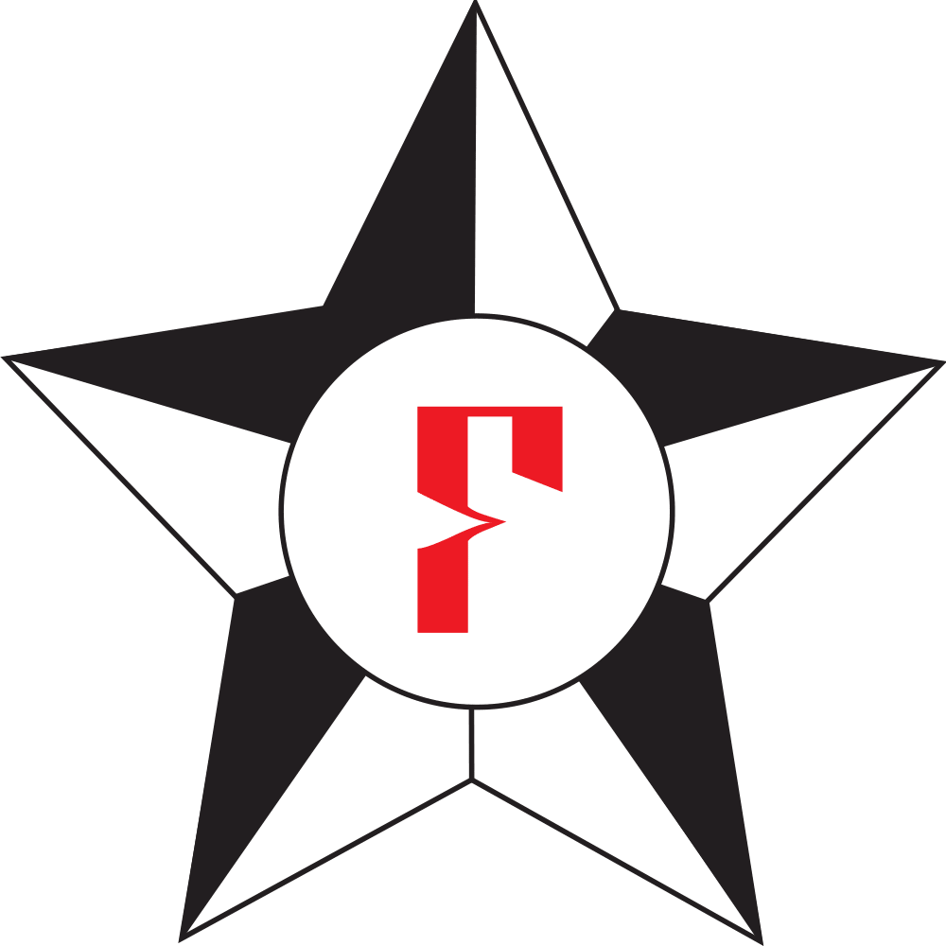
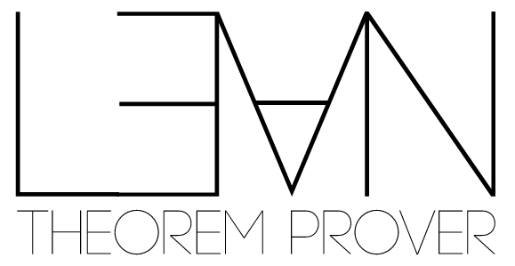
Everest 2016—2021: Verified Components for the HTTPS
Ecosystem
three years in!
Services & Applications
Edge
cURL
WebKit
Skype
IIS
Apache
Nginx
Clients
Servers
HTTPS
Certification Authority
X.509
ASN.1
Strong verified security
Widespread deployment
Trustworthy, usable tools
Growing expertise in high-assurance software development
TLS
***
RSA
SHA
ECDH
AES
Crypto Algorithms
Network buffers
Untrusted network (TCP, UDP, …)
Notes:
Fully-verified standards-compliant replacement
- We will prove cryptographic security, not just eliminate bugs.
- As a result, we rule out both past attacks, and attacks we haven’t even thought of yet
Many academically successful verification projects. Few deployments.

Slide 8
A timeline: years I, II and III of the Everest era
WinQUIC (2018)
MirageOS (2019)
Azure CCF (2019)
Deployments
Tezos blockchain (2018)
Firefox (2017)
WireGuard VPN (2018)
Signal* library (S&P 2019)
EverParse library (Usenix 2019)
EverCrypt provider (2019)
TLS Record Layer (S&P 2017)
HACL* library (CCS 2017)
Applications
Tools
Everest future!
F* (POPL 2016)
Vale (Usenix 2017)
F* (POPL 2018)
F* (ESOP 2019)
Vale (POPL 2019)
Low* (ICFP 2017)
F* (POPL 2017)

Slide 9
Future of Everest ?
Hyper-V (?)
BoringSSL (??)
Deployments
Skype (?)
web server (?)
miTLS
Applications
Tools
Everest onwards!
F* (POPL 20XX)

Slide 10
EverCrypt: a core (standalone) component of the TLS verified stack
lots to say
about protocols
miTLS 1.3
confidentiality
integrity
record layer
key derivation
message parsing & formatting
EverCrypt
EverParse
non-malleability
side-channel resistance
HACL* (Poly1305, Curve25519, Chacha20, etc.)
ValeCrypt (Poly1305, Curve25519)
today’s
focus
lots to say
about parsers
+ memory safety, functional correctness

Slide 11
What is a cryptographic provider?
A collection of algorithms (exhaustive)
Several implementations (multiplexing)
APIs grouped by family (agility)
Easy-to-use API (CPU auto-detection)

Slide 12
An essential piece of software
A cryptographic provider is useful beyond secure communications, e.g.
file encryption
secure enclaves
document signatures
cryptocurrencies
any modern piece of software

Slide 13
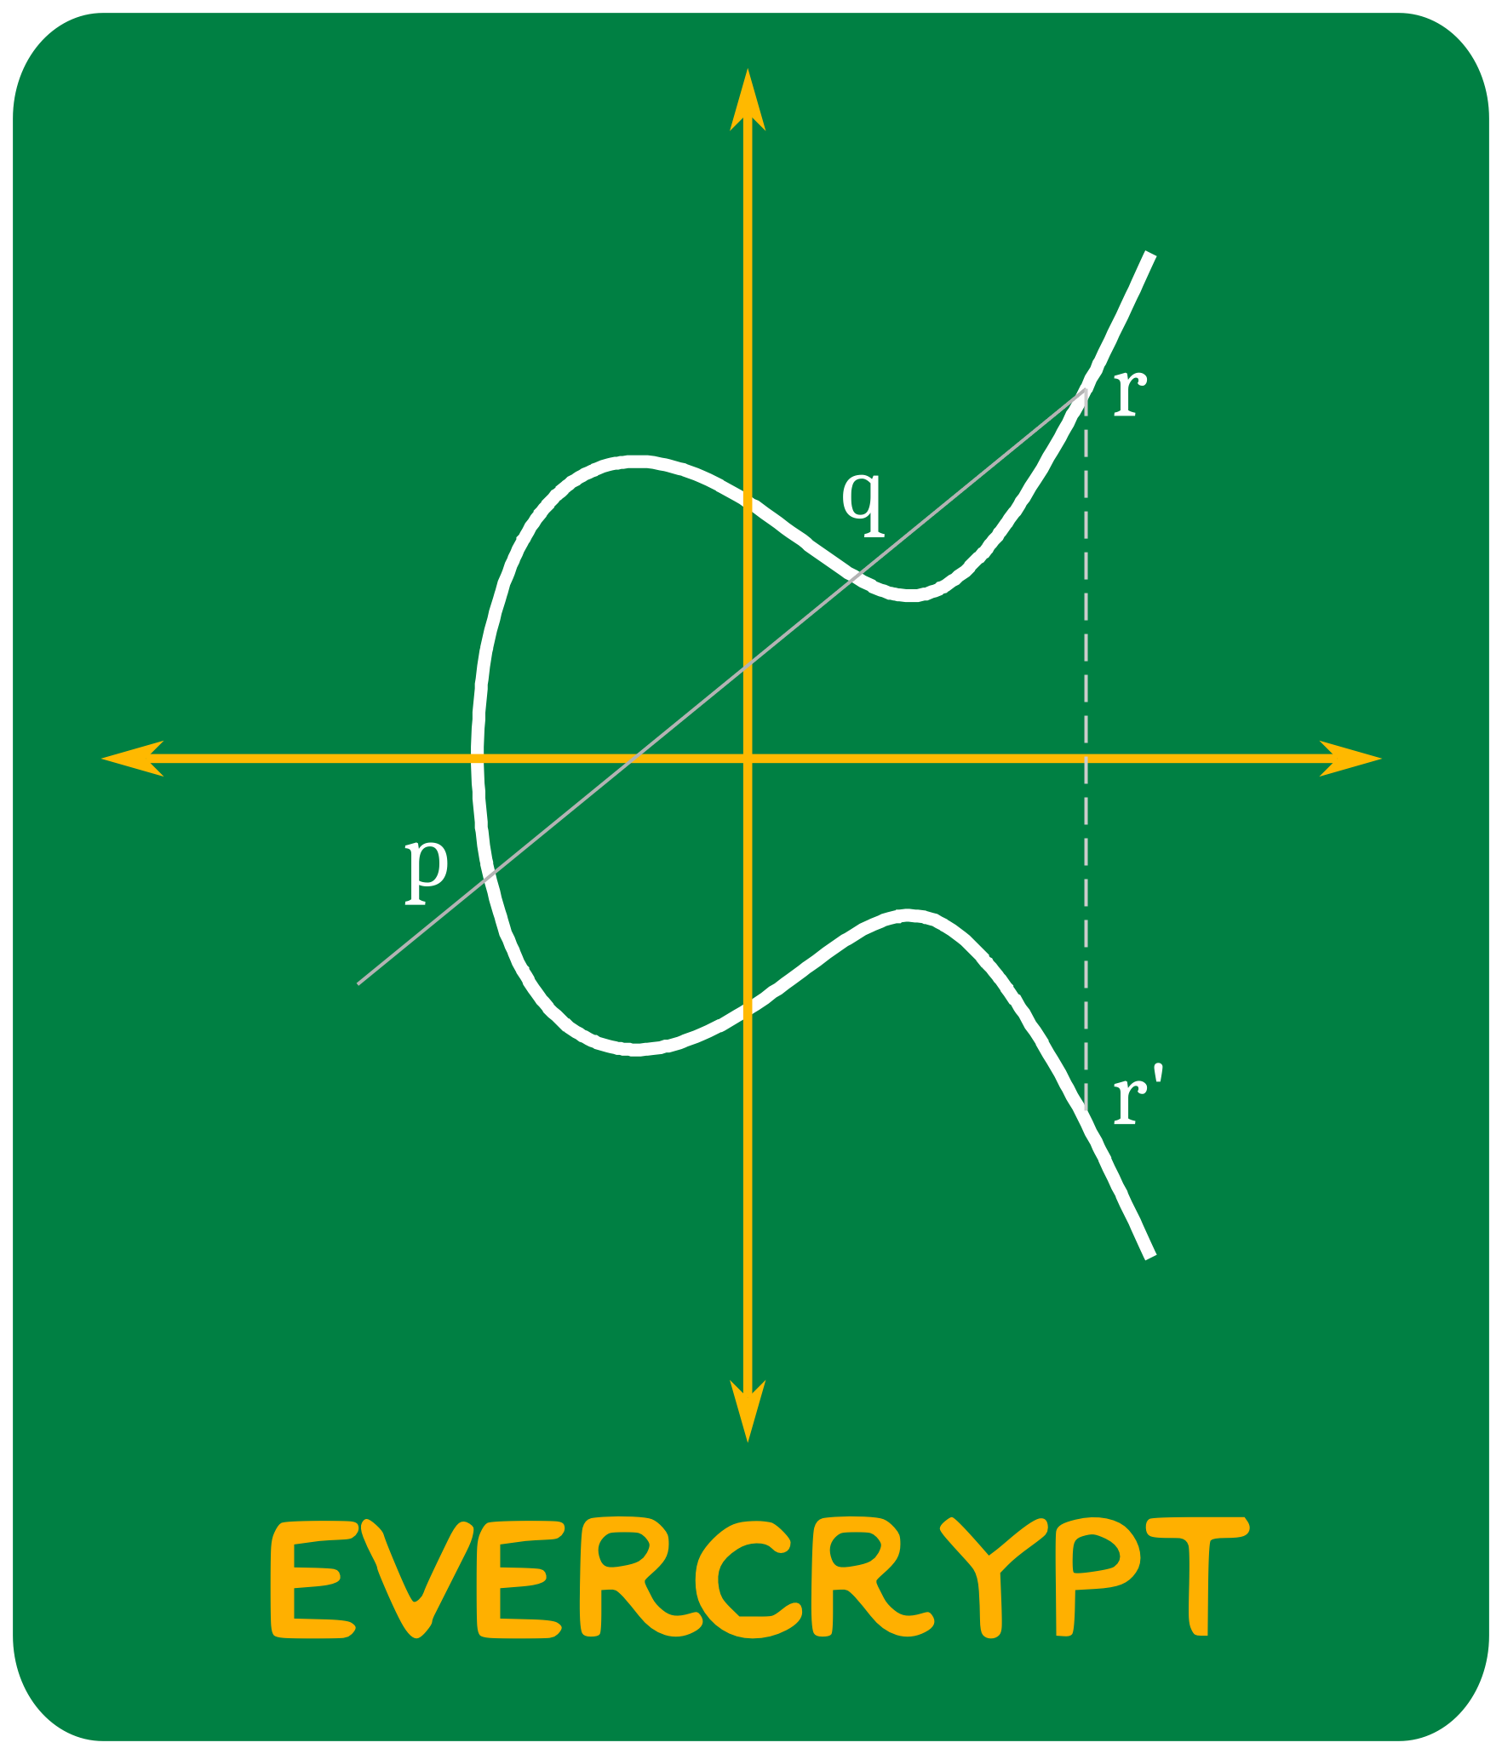
What is a cryptographic provider?
(libcrypto)

Slide 14
A brief reminder: why verify cryptographic algorithms?

Slide 15
Circa 2006 (undergrad) throwback
$$GF\left(q\right) \text{when} \text{q}\text{ = }p^{n}$$
can be defined using the polynomial ring with coefficients in GF(p):
$$GF\left(p\right)[X]$$
quotiented by the ideal generated by an irreducible polynomial P of degree n
$$GF\left(p\right)\left[X\right]/P$$
and that’s a field (younger me used to know why)
“the math”

Slide 16
My former self didn’t know this would be useful!
Evaluate polynomials in this field to get an authentication code! (see also: Poly1305)
GHASH (AES-GCM):
$p = 2^{128} (q=2, n=128)$
P = $x^{128}+x^{7}+x^{2}+x+1$
“the application”

Slide 17
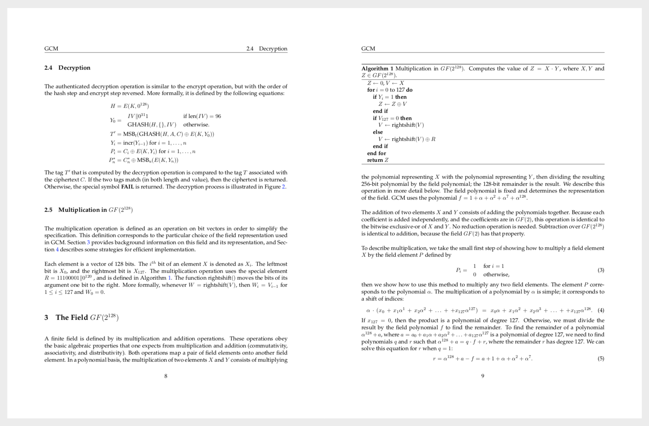
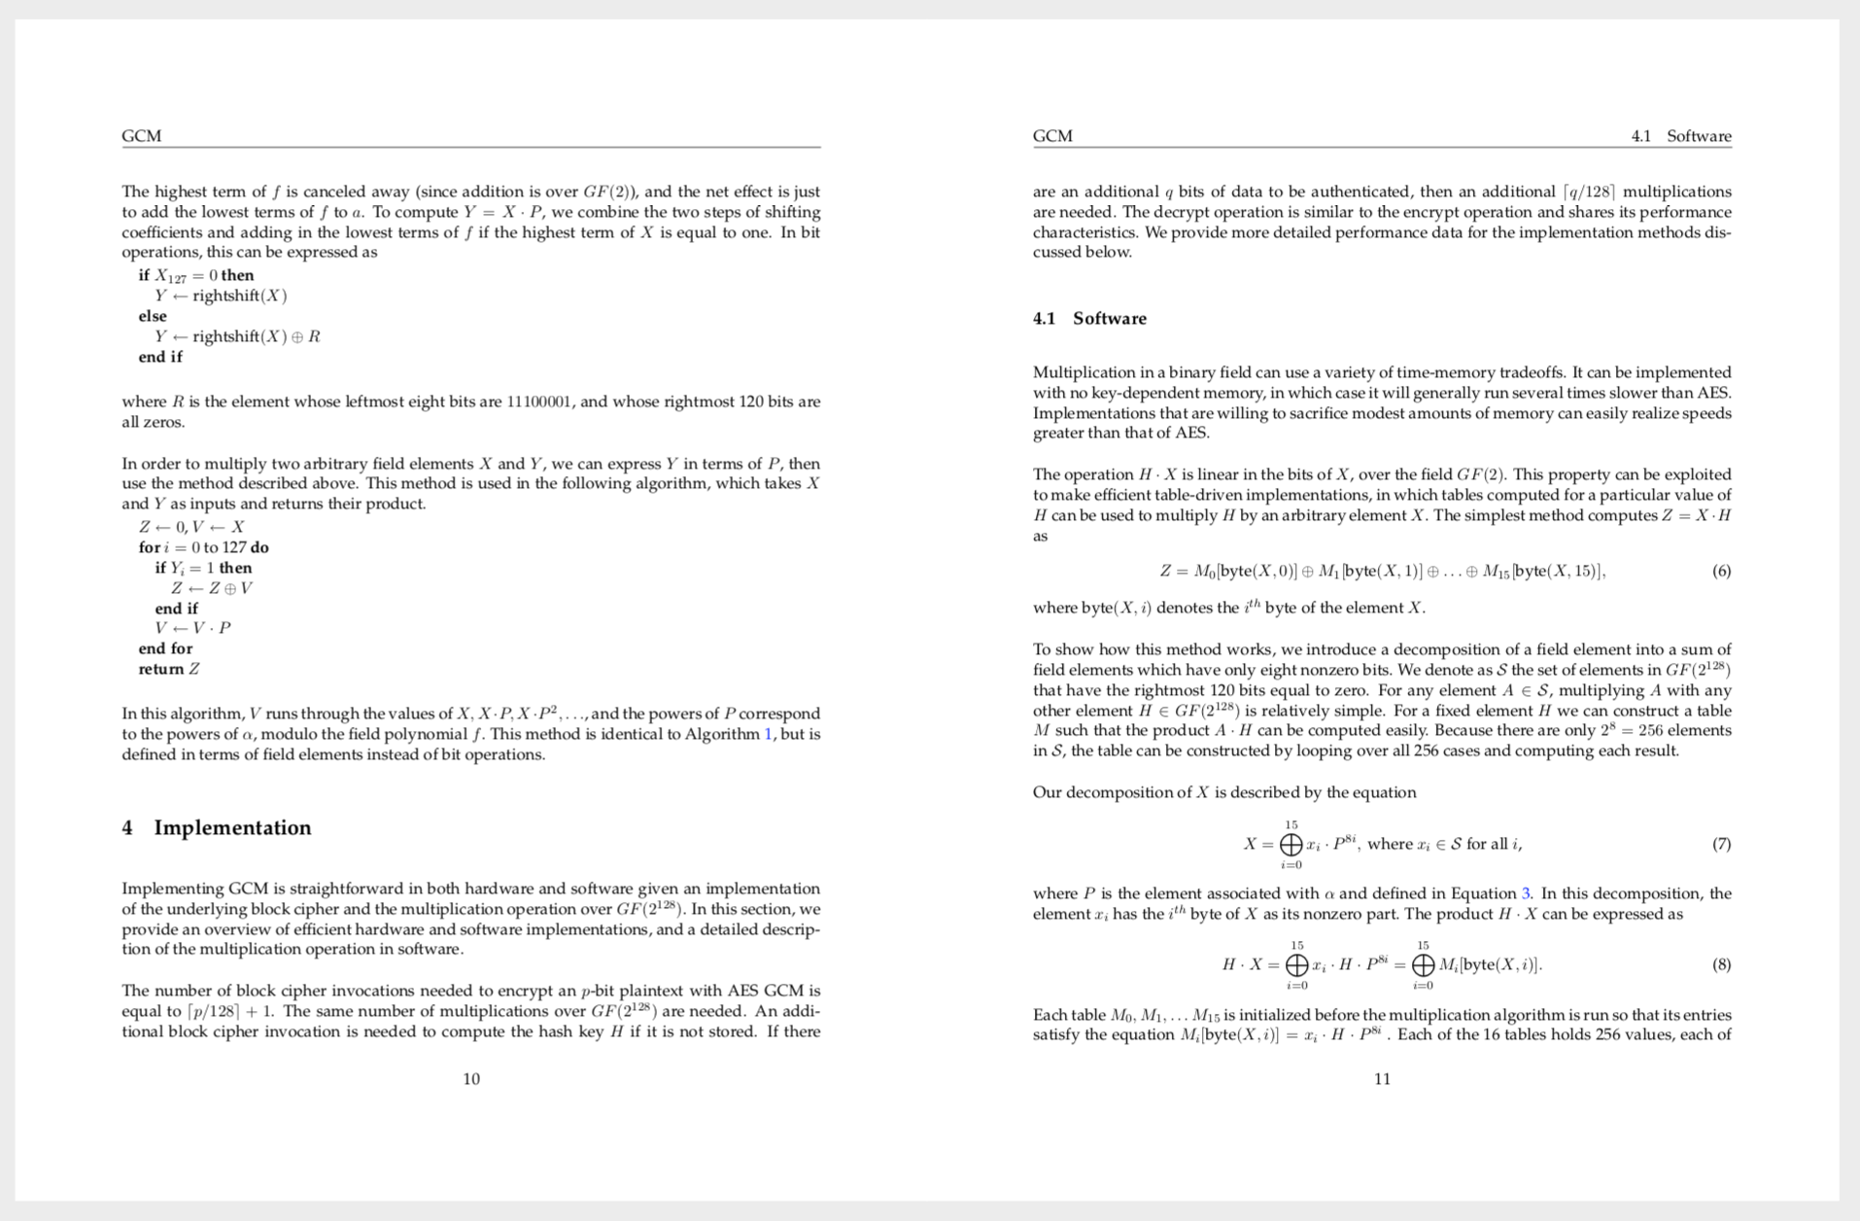
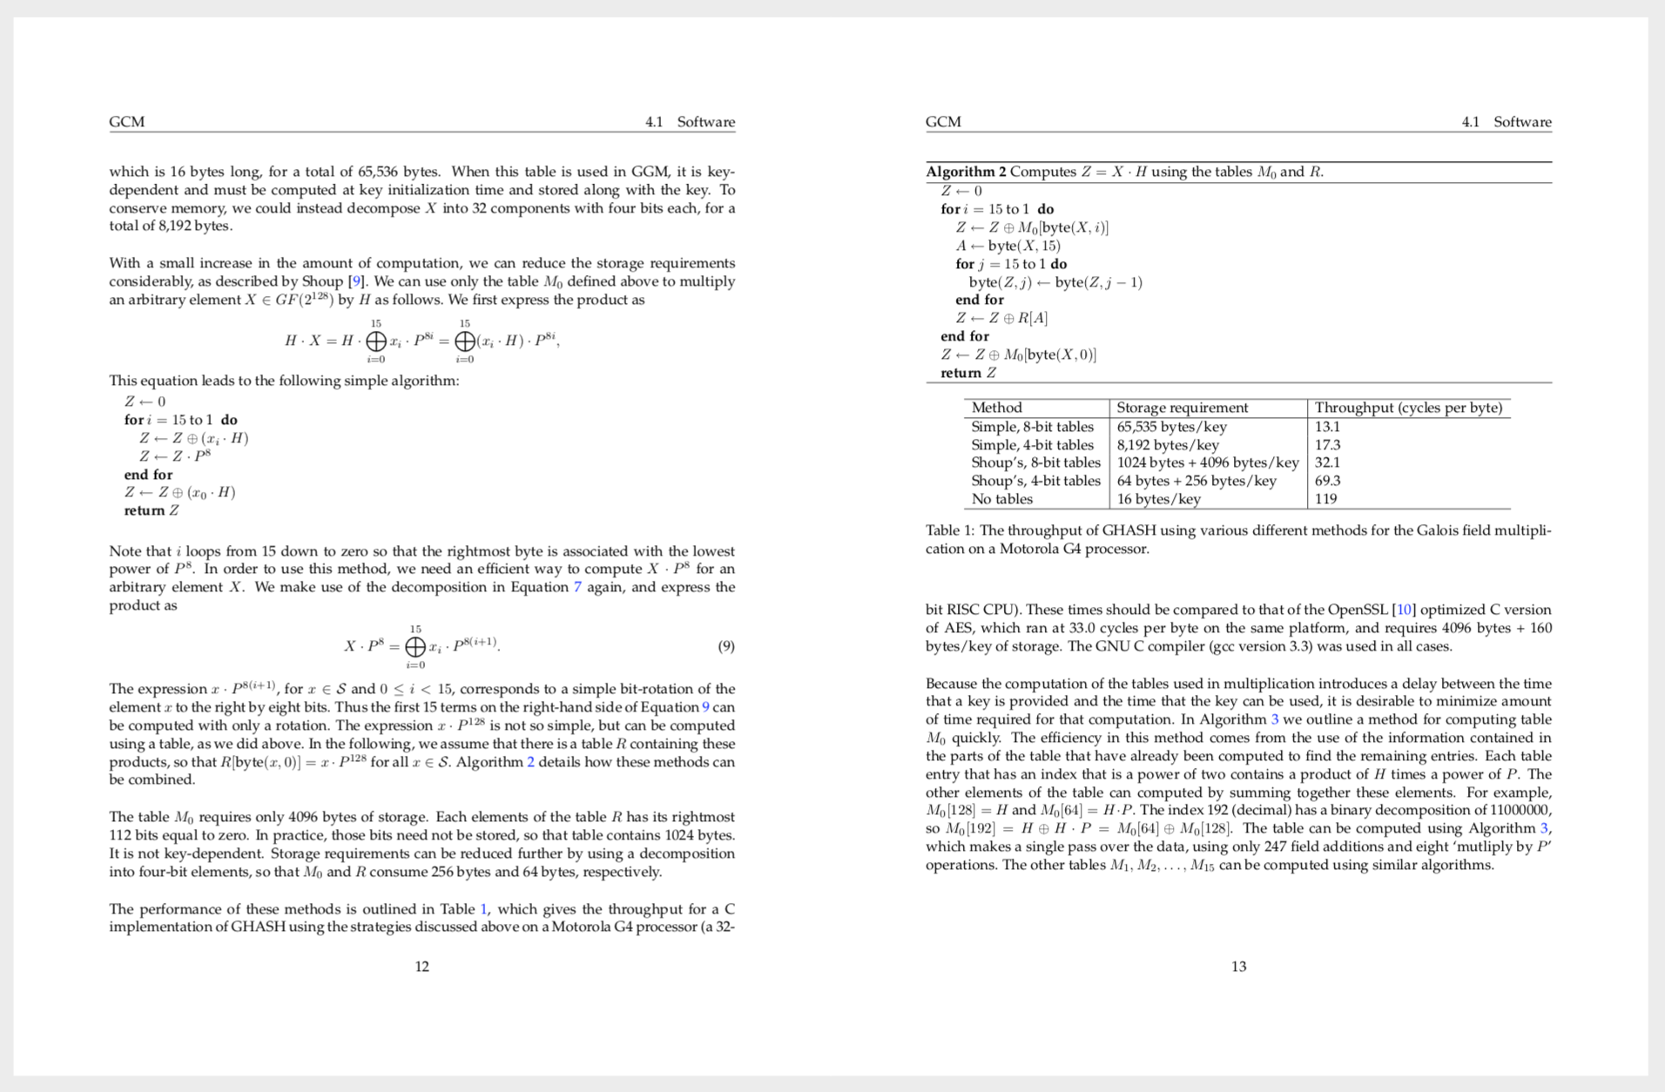
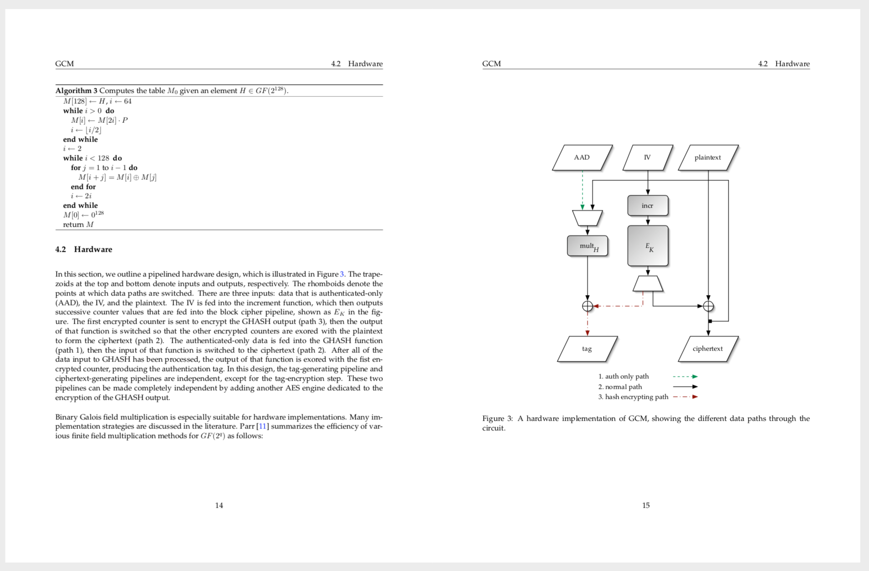
Distilling the math for implementors
“the algorithm”

Slide 18
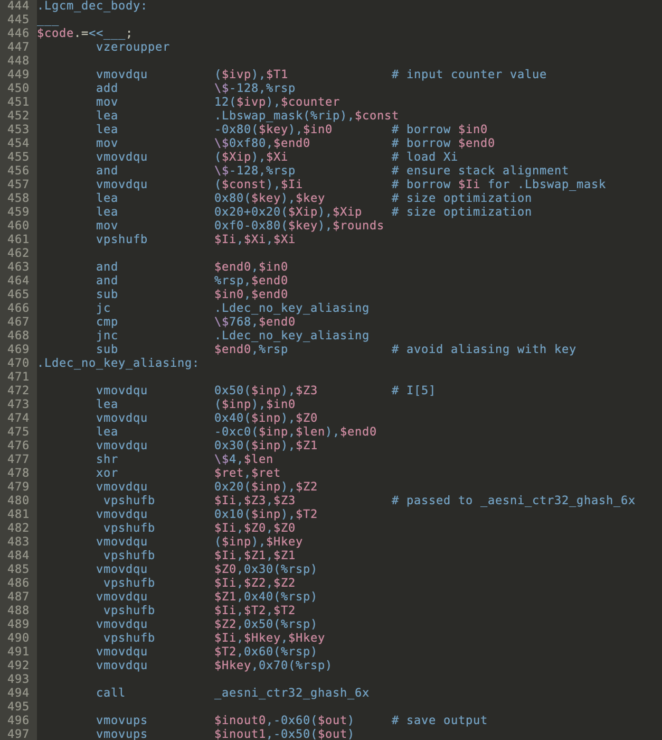
Writing the actual code
A long way from quotienting a ring by an ideal
“the reality”

Slide 19
What could possibly go wrong?

Slide 20
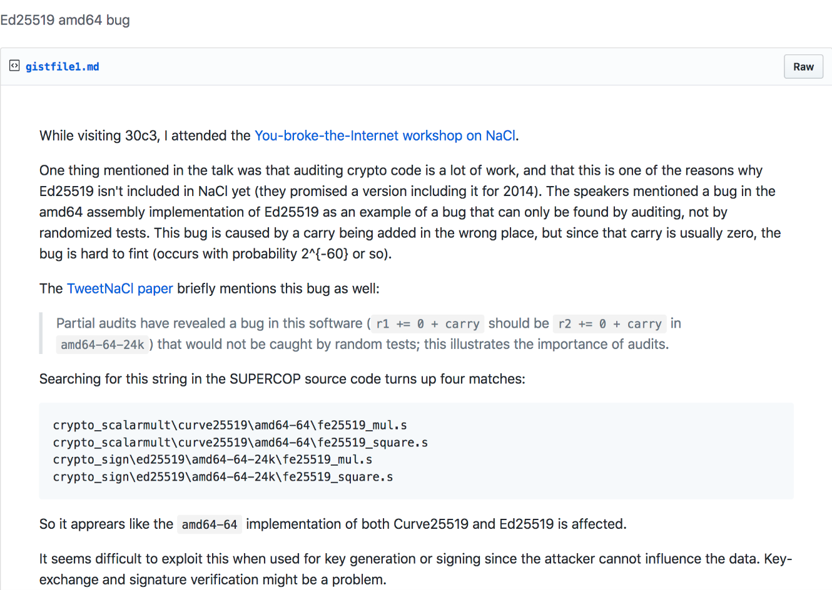
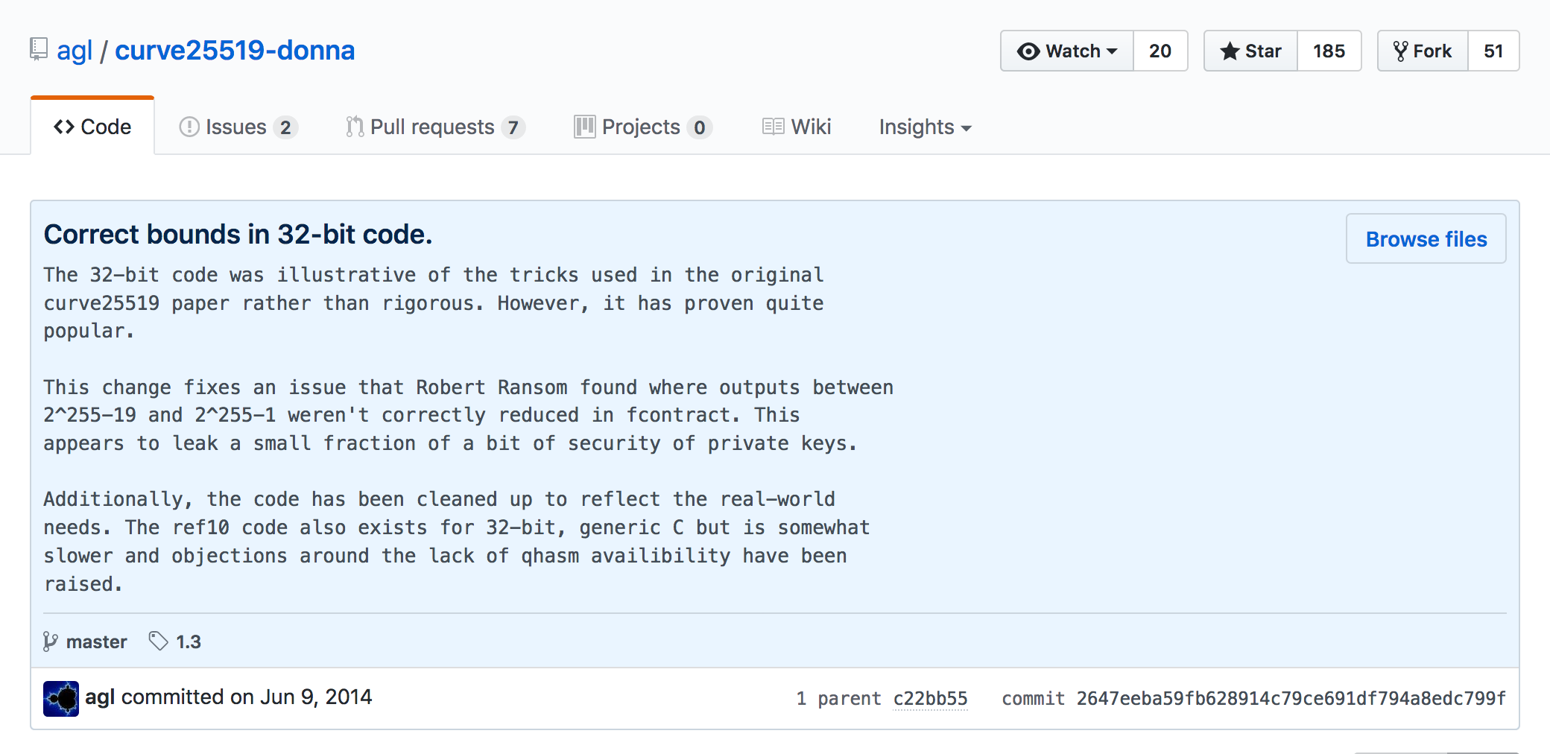
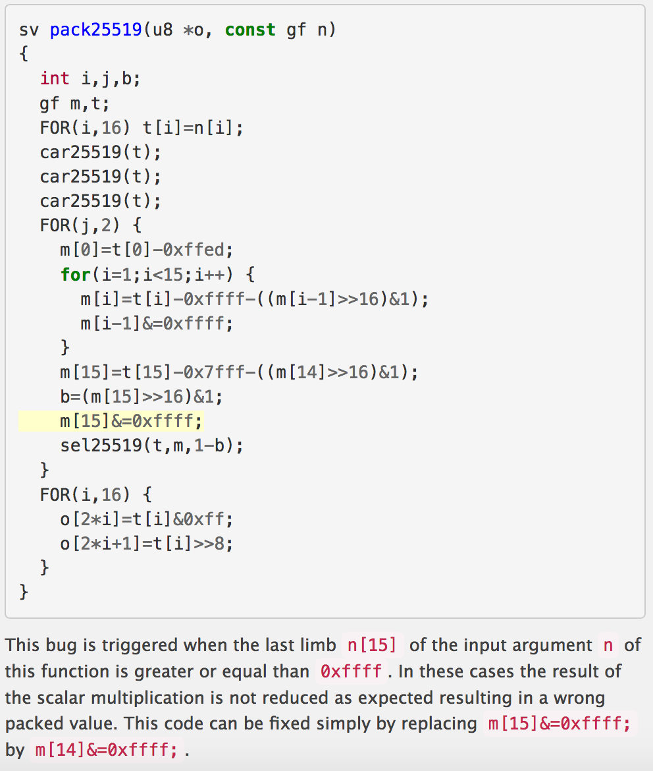
Many bugs in Curve25519 implementations (C and assembly)
NaCl (asm)
Curve25519-donna
TweetNaCl

Slide 21
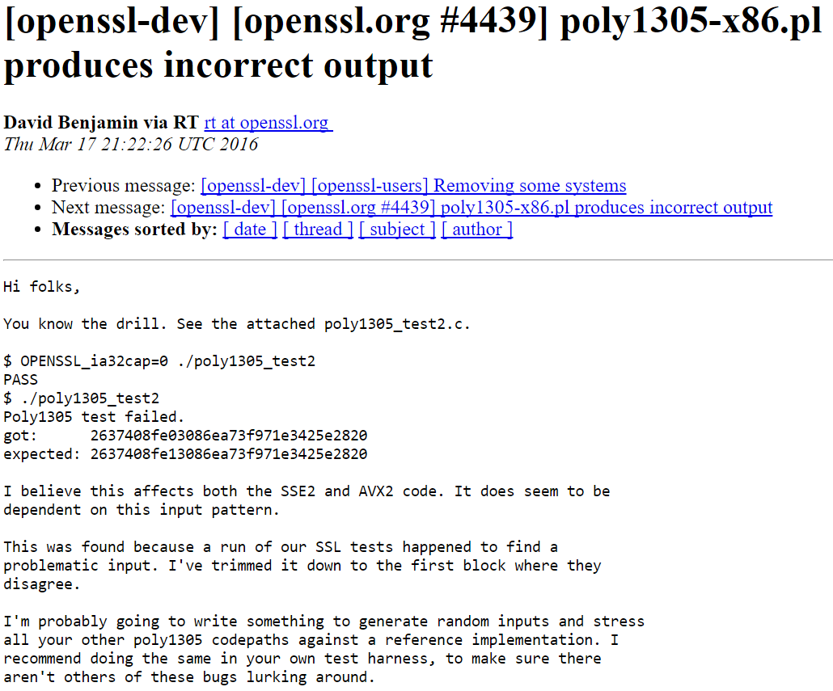
3 Bugs in OpenSSL implementation of Poly1305 last year
Low*
“These produce wrong results. The first example does so only on 32 bit,
the other three also on 64 bit.”
“I believe this affects both the SSE2 and AVX2 code. It does seem to be
dependent on this input pattern.”
“I'm probably going to write something to generate random inputs and stress
all your other poly1305 code paths against a reference implementation.”

Slide 22
Implementation bug in AES-GCM

Slide 23
Implementation bug in Windows SymCrypt
Potential DDOS.

Slide 24
Program verification!

Slide 25
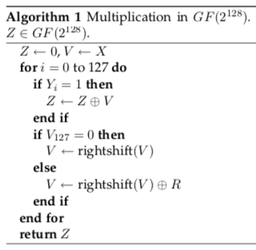
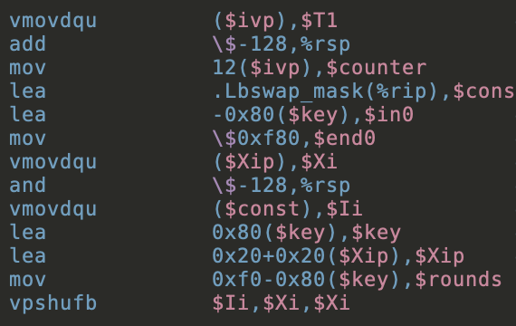
$GF\left(2^{128}\right)$ = $$GF(2)[X]/(x^{128}+x^{7}+x^{2}+x+1)$$
refines
refines

Slide 26
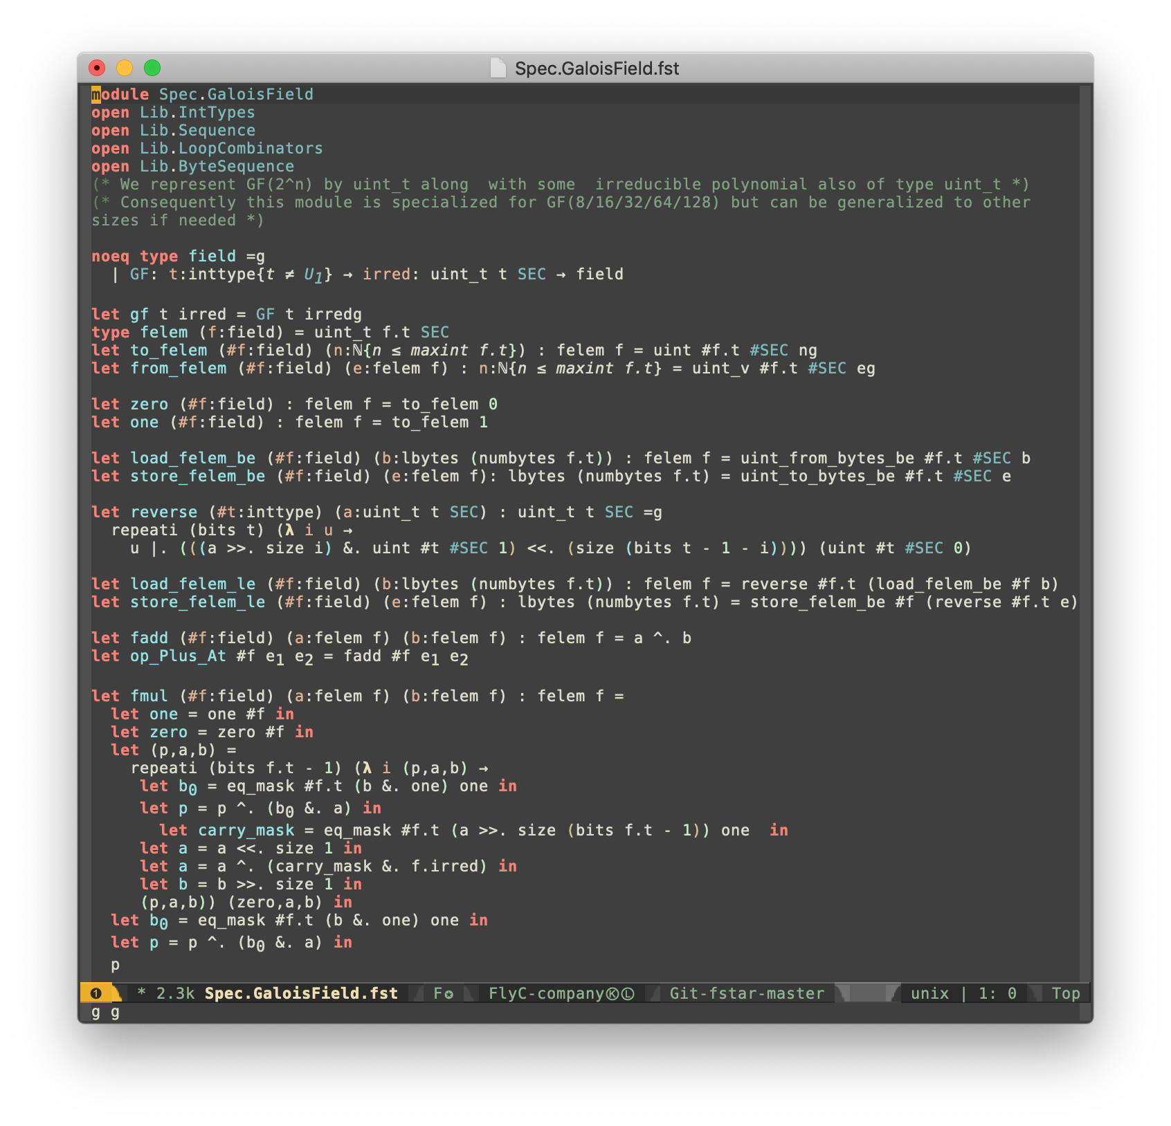
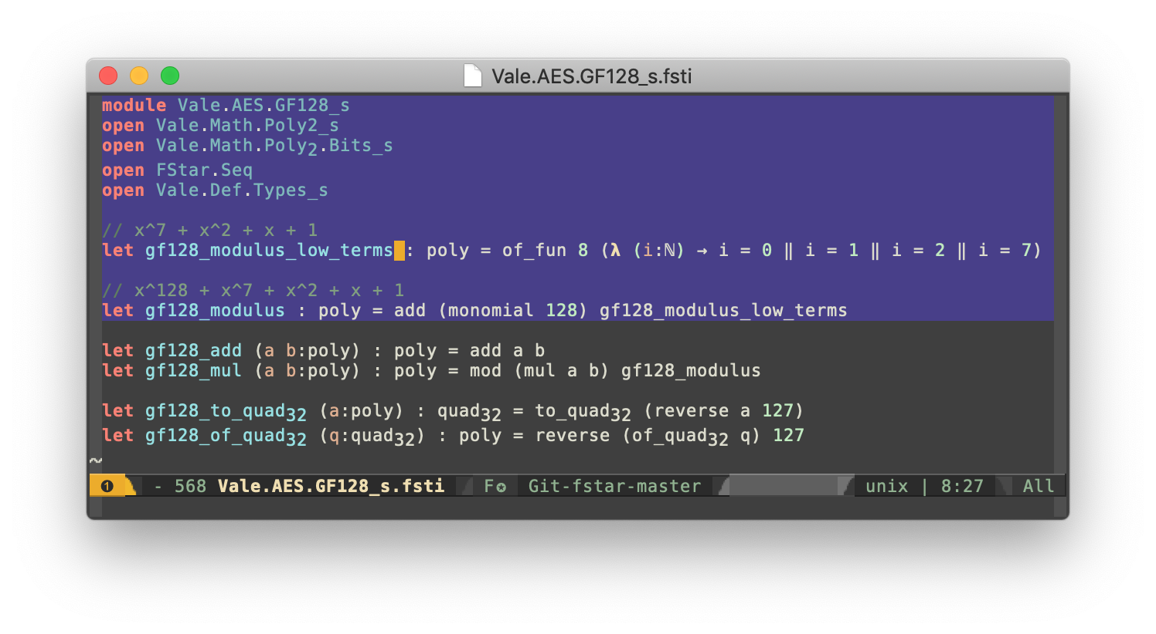
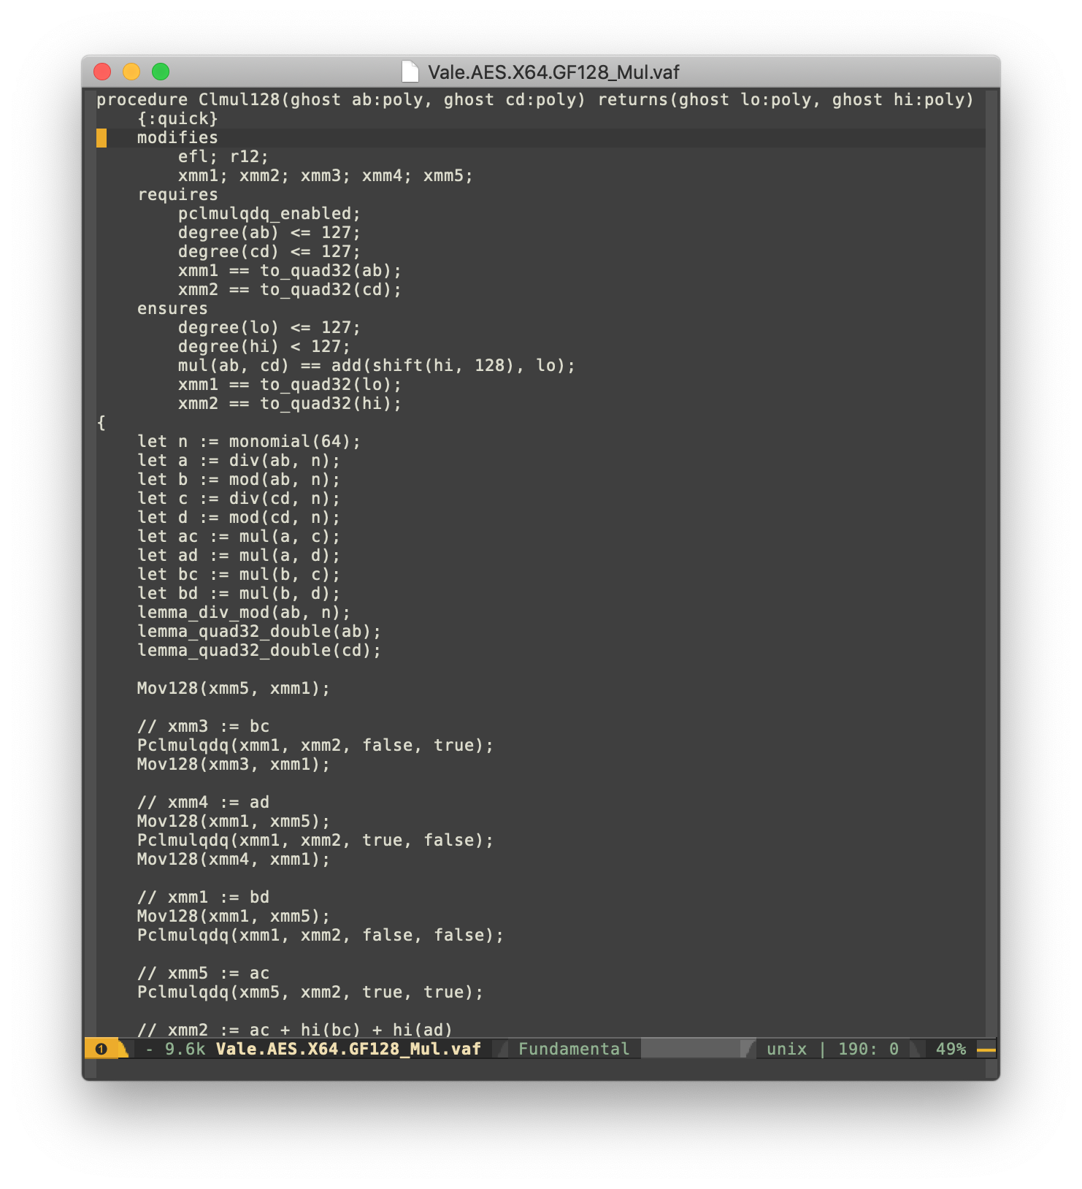
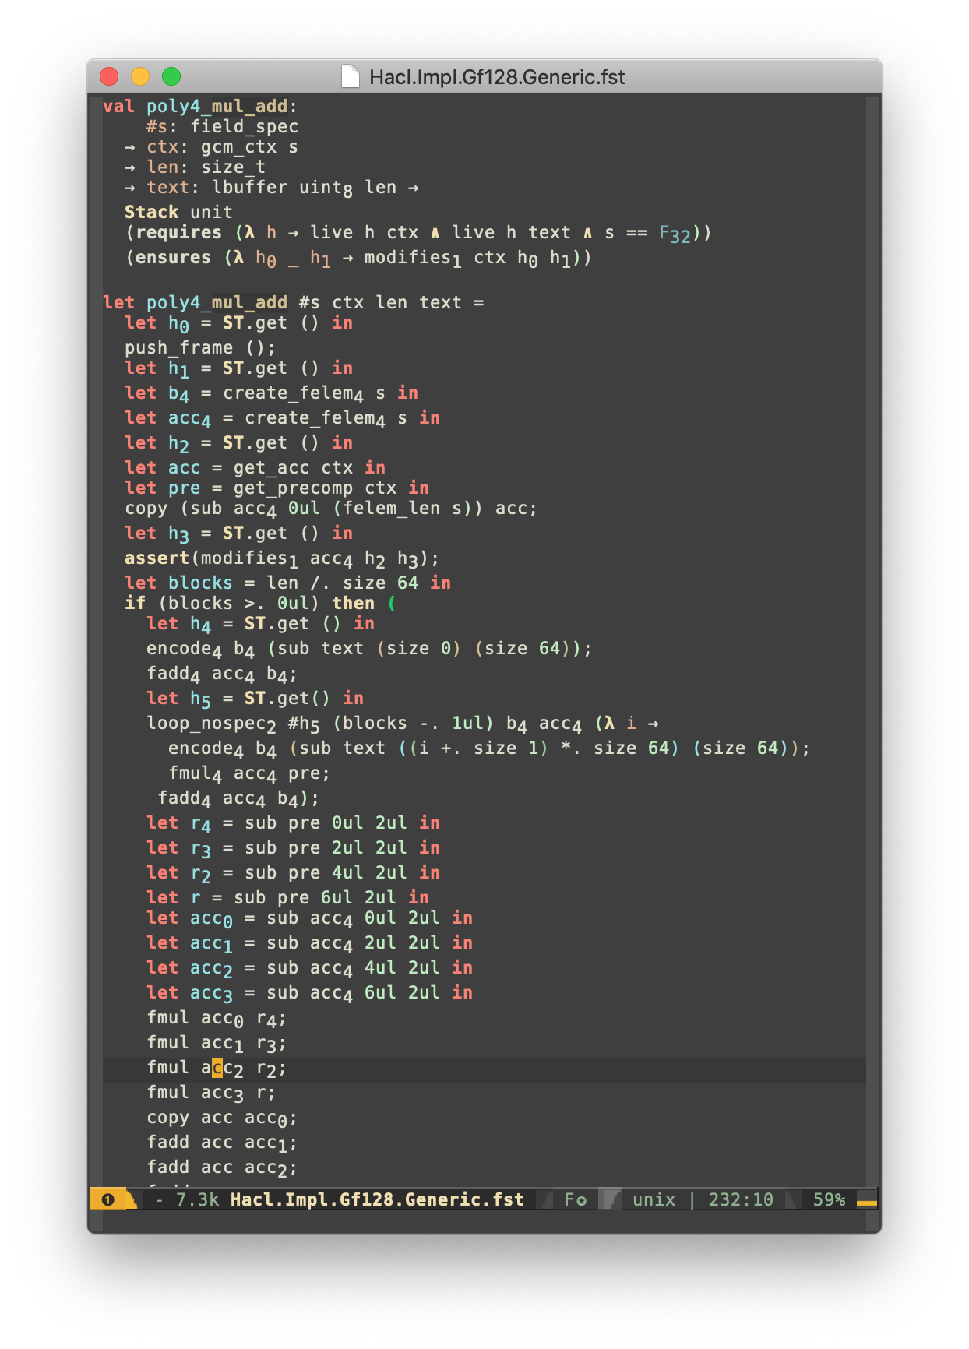
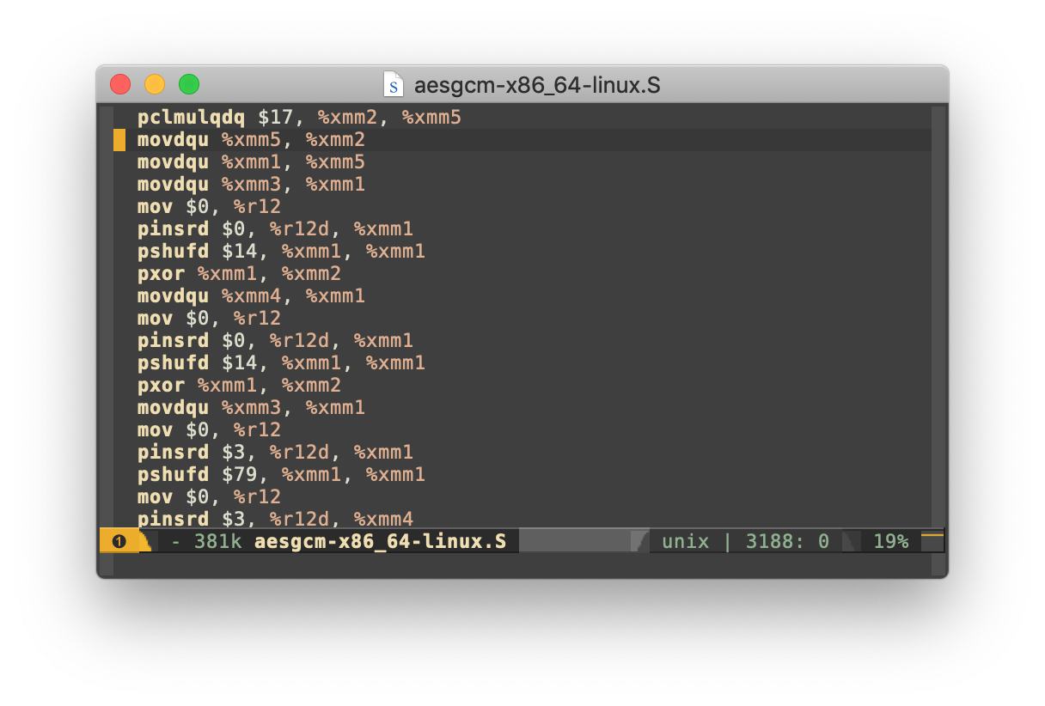
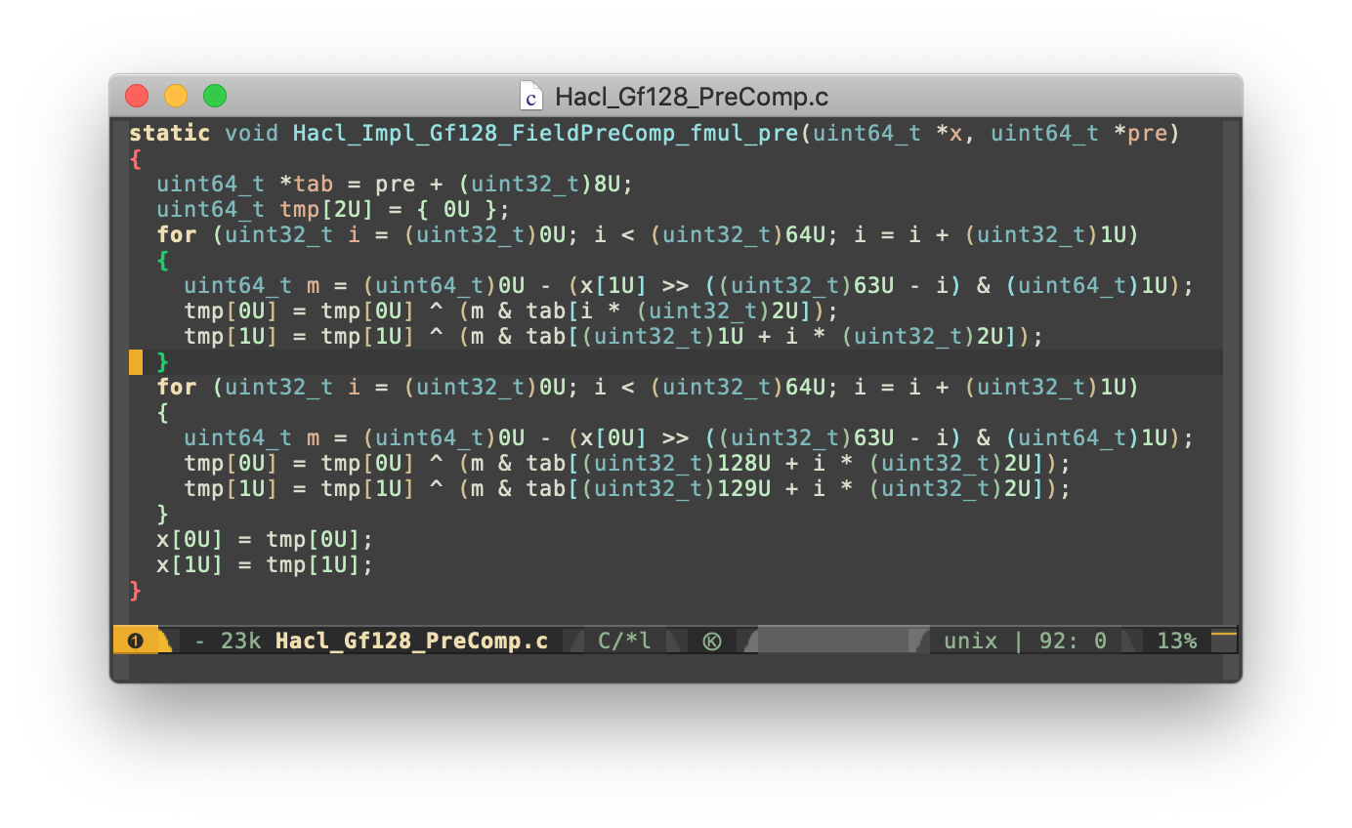
Specification (“the mathematical truth”)
spec-test.exe (“testable specification”)
via ocaml
proof
Pseudo-code (“implementation blueprint”)
proof
proof
Vale
Vale/F* (“assembly-like”)
Low* (“C-like”)
via Vale printer
via KreMLin compiler
Assembly (.asm)
C code (.c, .h)

Slide 27
What is verified?

Slide 28
What do we verify?
Safety
Memory- and type-safety. Mitigates buffer overruns, dangling pointers, code injections. No undefined behavior.
Functional correctness
Our fast implementations behave precisely as our simpler specifications.
Secrecy
Access to secrets, including crypto keys and private app data is restricted according to design.
Our specifications and implementations are written together, in one language (F*) Drift between spec and implementation cannot happen.
Each application can do custom proofs beyond functional correctness and safety:
non malleability (parsers)
crypto games (TLS)
security reduction (Merkle Trees)
etc. etc.
Notes:
Secrecy includes side-channel resistance.
All of this applies to both code in F* and in Vale. We verify the assembly code follows the “rules of the road” for calling convention, as well as that no secrets are leaked on the stack or in any register (even x86 EFLAGS) when we return out of assembly code.

Slide 29
Will Everest be perfectly secure? No.
Our models make assumptions, e.g.
The private signing key must remain private and not used in other protocols
We assume security for core crypto algorithms, based on hard problems.
Our models may not be complete
Our detailed models are designed to exclude all known attacks, but may be blind to new classes of attack (hardware faults,…)
Our verification toolchain may be buggy
Our TCB includes Z3, Kremlin, C compilers… Efforts to reduce it are under way.
Computer-aided verification also has advantages: once in place, proof verification is
automated (but takes hours)
compositional (we can re-use verified component as building blocks for others)
maintainable (we can extend or modify our code, and re-check everything as part of CI).
Notes:
To reduce the TCB, we can target CompCert, use alternate solvers, etc.

Slide 30
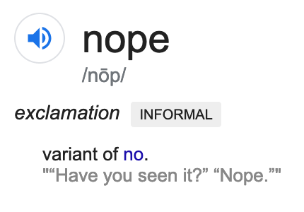

Slide 31
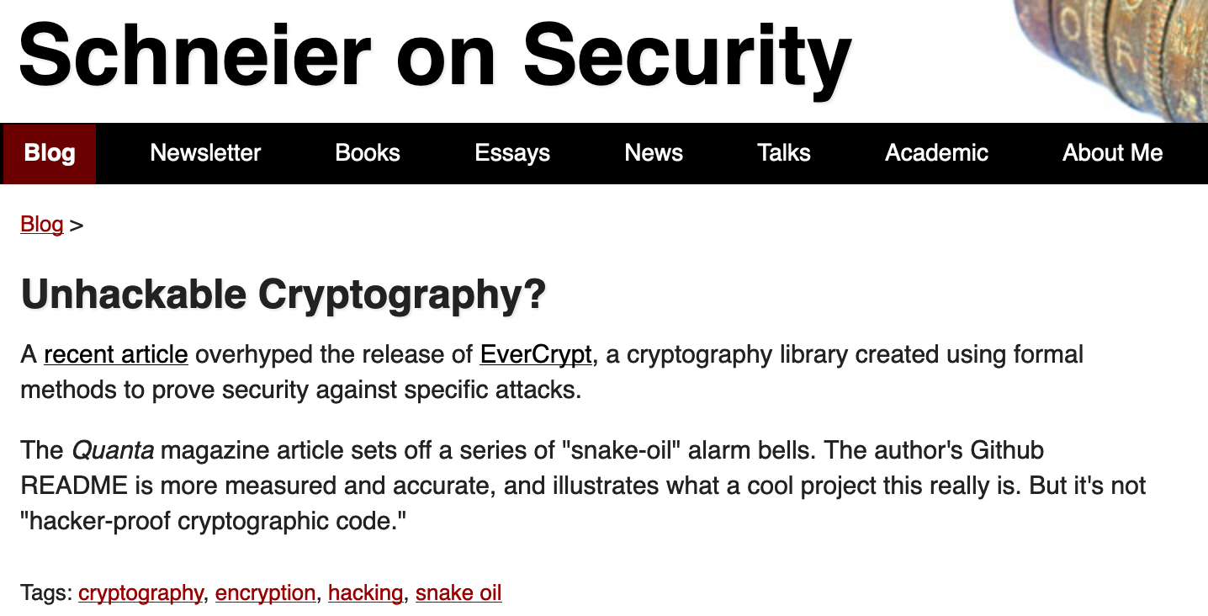
same sentiment on: Hacker News, Reddit, Slashdot, twitter, etc.

Slide 32
The Essence of EverCrypt

Slide 33
EverCrypt: no excuses industrial-grade crypto library, with full verification
EverCrypt
Vale/F* (“assembly-like”)
Low* (“C-like”)
A single artifact for clients to use
State-of-the-art performance
A single verification result (Vale or Low*)
Deep integration for seamless interop
Total abstraction for clients

Slide 34
Algorithm | C version | ASM version | Agile API
AES-GCM |  | ✔ (AESNI) | ✔
ChachaPoly | ✔ |  | ✔
MD5, SHA1 | ✔ |  | ✔
SHA2 | ✔ | ✔ (SHAEXT) | ✔
SHA3 | ✔
Blake2 | ✔
HMAC | ✔ |  | ✔
HKDF | ✔ |  | ✔
Curve25519 | ✔ | ✔ (BMI2 + ADX)
Ed25519 | ✔
Chacha20 | ✔
AES 128, 256 |  | ✔
AES-CTR |  | ✔
Poly1305 | ✔ (+ AVX + AVX2) | ✔ (X64)

Slide 35
One algorithm, several implementations (multiplexing)
Verifies multiple implementations (Vale & Low*) against one specification
Isolates clients from processor and target details
Auto-detects static & dynamic features
Eliminates illegal instruction errors
Expected by an industrial-grade library

Slide 36
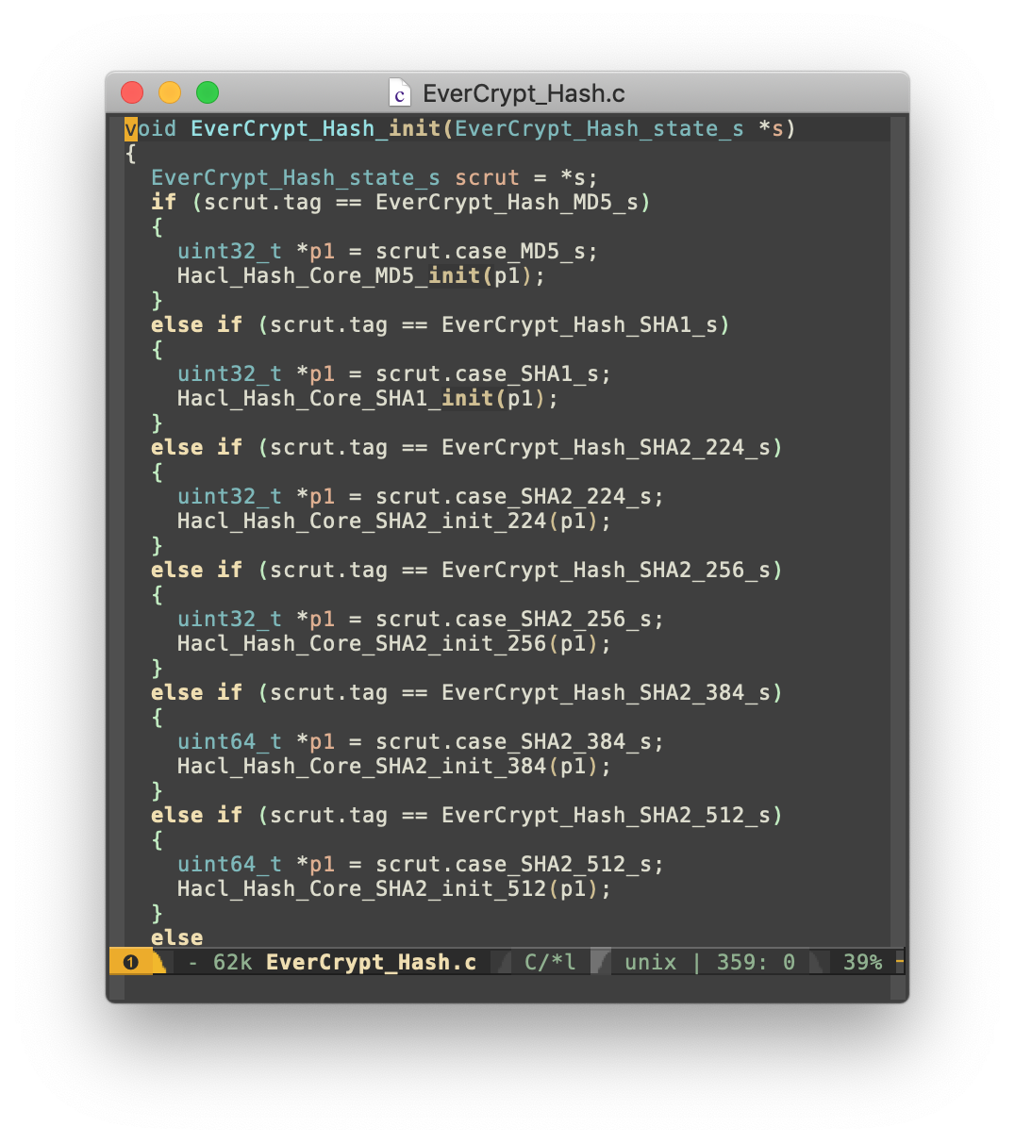
Several algorithms, one API (agility)
Verifies that multiple algorithms fit the same family of specifications
Allows clients to switch between algorithms (crucial for TLS)
Uses F* meta-programming to templatize the code
Expected by an industrial-grade library

Slide 37
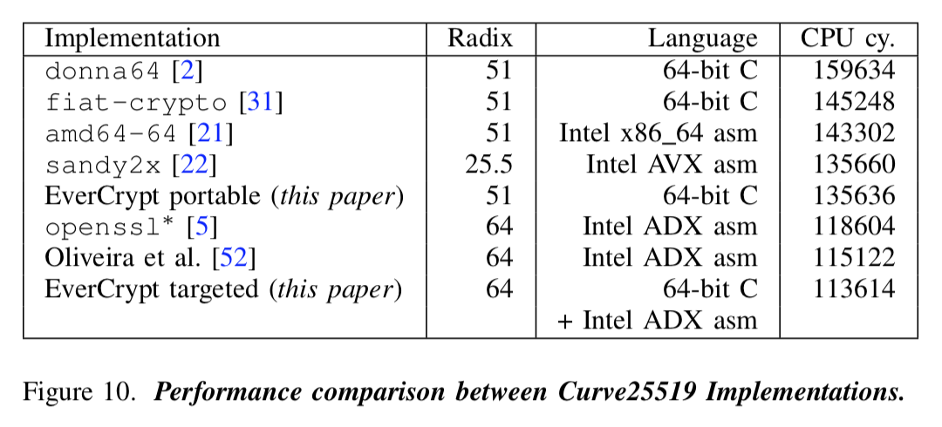
Deep integration between C and ASM (speed)
Verification allows more optimizations and does not compromise speed. Mundane parts of the algorithms are written in Low* while critical bits are in Vale. A new verified interop layer ensures sound interoperation between two languages.

Slide 38
A foundation for verified apps (abstraction)
C client
Signal*
Merkle tree
clients (+ libquiccrypto, miTLS, etc.)
EverCrypt (C API)
agile, multiplexing library
HACL* (C)
Vale (ASM)
cryptographic providers
EverCrypt seals the abstraction, meaning verified clients are shielded from underlying verification details.

Slide 39
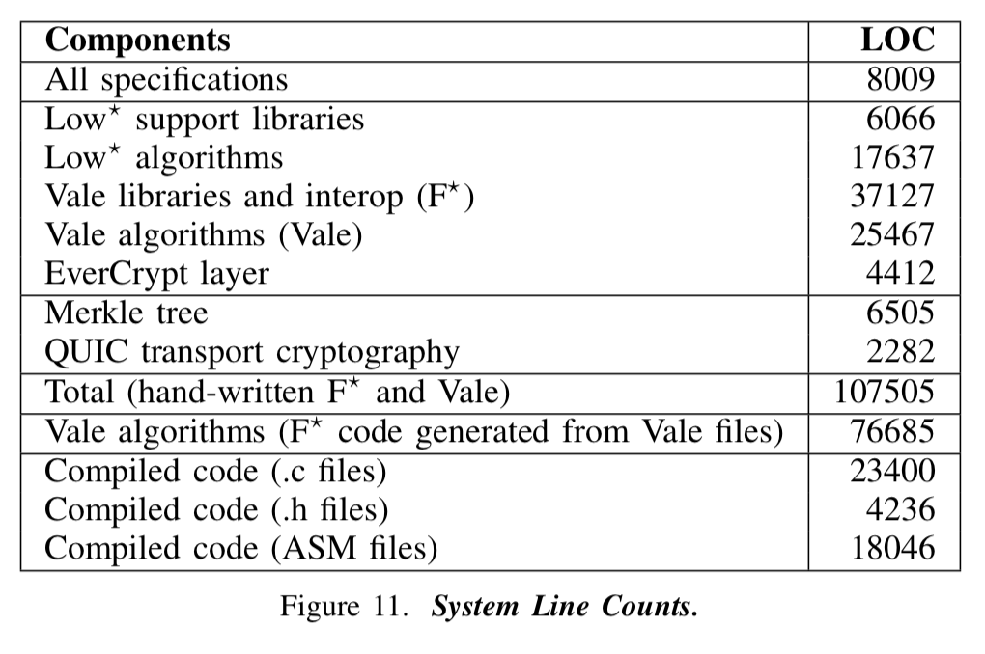
A significant verification effort (bringing all of Everest together)

Slide 40
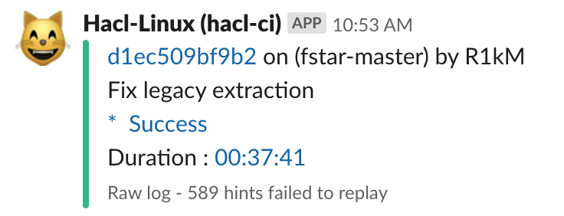
A significant team effort (bringing all of Everest together)
First project where everyone is truly on the same codebase, same repository
Unify abstractions, build systems, tools, APIs
Review, integrate, keep under CI
Proper release process, changelog, stable APIs

Slide 41
Two case studies: AES-GCM & Curve25519

Slide 42
We have a fast verified AES-GCM
Fastest
OpenSSL
assembly
code

Slide 43
Optimizing AES-GCM
ciphertext₁
ciphertext₂
ciphertext₃
ciphertext₄
add
add
add
add
init-
hash
secret
mul
secret
mul
secret
mul
secret
mul
P
mod
P
mod
P
mod
P
mod
Important optimizations:
delay mod operations
parallelize add/mul operations
math+bitwise tricks for mod
careful instruction scheduling
(((init + c₁) * s % P + c₂) * s % P + c₃) * s % P
(((init + c₁) * s + c₂) * s + c₃) * s % P
((init + c₁) * s³ + c₂ * s² + c₃ * s¹) % P
((init + c₁) * (s³ % P) + c₂ * (s² % P) + c₃ * s¹) % P

Slide 44
Optimizing Curve25519
match s with
| M51 -> F51.fmul1 out f1 f2
| M64 -> F64.fmul1 out f1 f2
Low*
val fmul1 (dst:u256) (a:u256) (b:uint64{v f2 < pow2 17}) :
Stack unit
(requires fun h -> adx_enabled /\ bmi2_enabled /\ ...)
(ensures ...)
Interop
procedure fmul1(...)...
lets dst_ptr @= rdi; inA_ptr @= rsi; b @= rdx;
requires adx_enabled && bmi2_enabled && ...
ensures ...
{
fast_mul1(0, inA_b); ... Mov64(b, 38);
carry_pass(false, 0, dst_b);
}
Vale

Slide 45
Deployments and applications

Slide 46
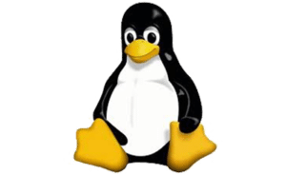
Level 1: cherry-pick approach
Example: Linux Kernel (ZINC). - Kernel already has multiplexing and CPU auto-detection facilities.
Taking EverCrypt Curve25519 (C/ASM)
Also took Fiat crypto
They want algorithms we don’t yet have
Also in that category: Firefox
The latter project takes the approach of modeling the algorithm in F* and proving the model correct, which F* is designed to optimize. Then — in a term of art which never fails to make me think of Arnold Schwarzenegger's Terminator descending into a bath of molten metal — the model is "lowered into" C (or in some cases, all the way into assembly language). According to Donenfeld, this produces C which, though slightly non-idiomatic, is surprisingly readable, and much more likely to be bug-free than human-written code. It also produces some of the fastest C implementations that exist, which he suspects is because the formal verification process removes certain things that are not obviously removable when you're working the mathematics out by hand.

Slide 47
Level 2: the whole library
Easiest approach: just take the whole directory
Expectations are higher for security-related applications
Beneficial peer pressure
Examples: Concordium & Tezos blockchains, remote attestation (UC Irvine), IOT...

Slide 48
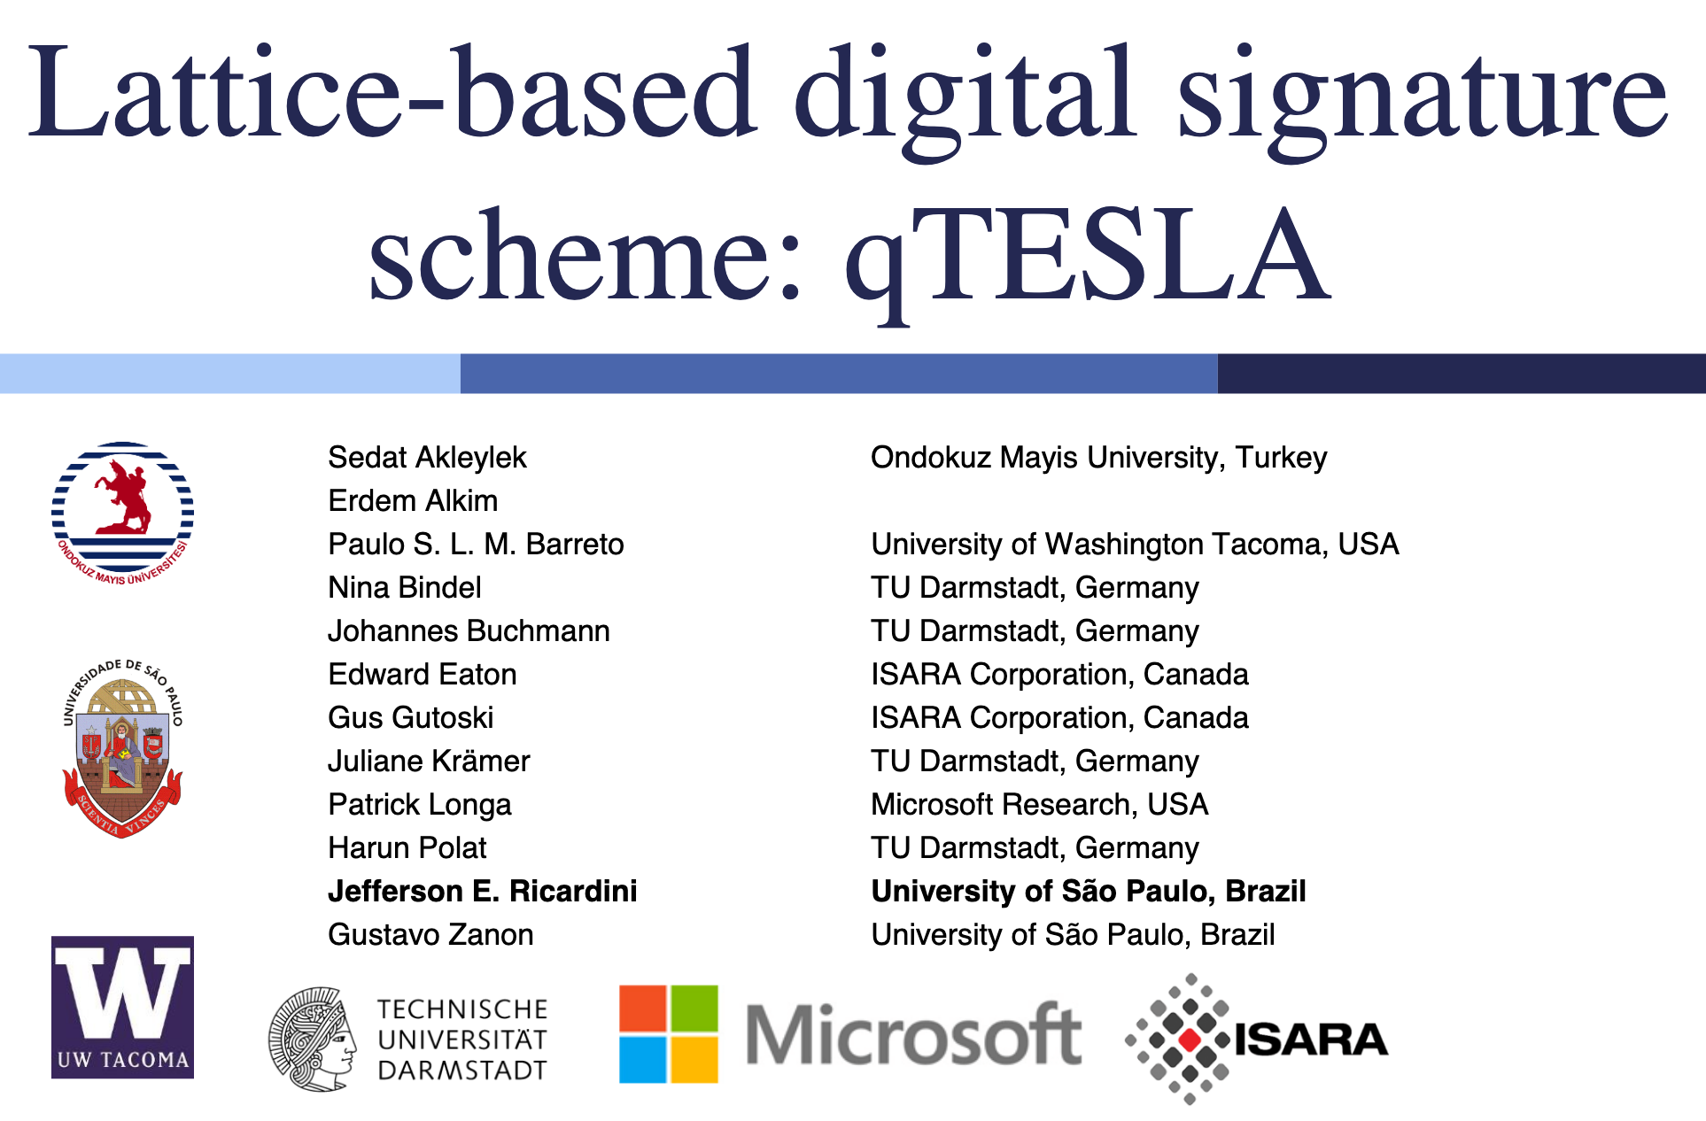
Level 3: extend
Formal verification an advantage for standards competitions (NIST)
Working with Security & Cryptography group
Post-quantum algorithms: qTESLA, Frodo
Fruitful collaboration

Slide 49
EverCrypt as a foundation for verified software
EverCrypt = a building block
Why just limit ourselves to TLS?
Several artifacts have been developed atop EverCrypt
shields clients from conflicting, disparate specifications in favor of crisp, unified cryptographic constructions

Slide 50
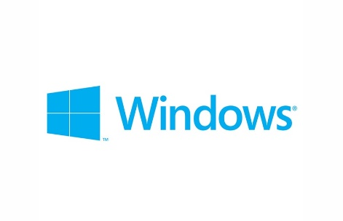
A custom provider: libquiccrypto
“The cryptographic toolbox one needs to implement QUIC”.
before
after
libquiccryto (C)
libquiccrypto (Low*)
✅ memory safety
✅ functional correctness
ad-hoc calls
EverCrypt (Low*)
✅ cryptographic model
HACL*
Vale
HACL*
Vale

Slide 51
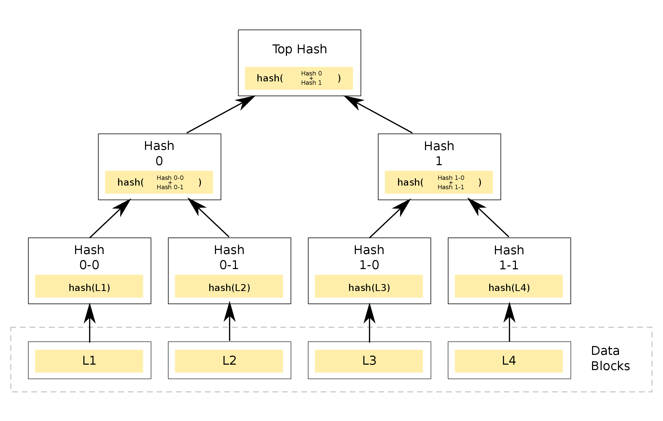
A complete component: Merkle tree
Used to verify integrity of a large number of blocks
Needs a hash algorithm
Needs the fastest hash for the give platform
Proof of collision resistance by reduction
By Azaghal - Own work, CC0, https://commons.wikimedia.org/w/index.php?curid=18157888
CCF uses EverCrypt
(Build 2019)

Slide 52
A full-fledged protocol: Signal*
Secure communications protocol
Used by: WhatsApp, Facebook Messenger, Signal, Skype
Sophisticated cryptography: X3DH, double-ratched
Forward secrecy, post-compromise security, etc. etc.
A verified implementation compiled to C and ...

Slide 53
A whole new target for EverCrypt: WASM
Shipped in all major browsers (including Edge)
WASM delivers portability and performance
LLVM backend (“emscripten”)
Opportunity:
Desktop applications are running on a web framework like Electron (e.g. Skype, Signal, VS Code, Atom, WhatsApp)
Framework support for cryptography is lacking (WebCrypto on the web, node.js crypto on the desktop)
A WASM backend for KreMLin:
Auditable and delivers competitive performance
An alternative, faster, less trustworthy backend: Low* -> C (via KreMLin) -> WASM (via LLVM)
EverCrypt for the web: enables instant access to the latest cryptographic primitives on both Desktop & Web
Applications already:
Use the WASM backend of KreMLin for verified, fast implementation of messaging protocols, including Signal (IEEE S&P 2019)

Slide 54
A vision for EverCrypt
An industrial-grade crypto provider is now a reality
already adopted
demonstrates OpenSSL’s libcrypto is no longer inevitable
Peer pressure to use verified code (good)
blockchains pushing for formal verification
skepticism of crypto is high (backdoors? magic constants? Russian S-BOX?)
open-source more nimble (Linux, BoringSSL, Firefox)
EverCrypt is at the forefront
breadth and scale of the verification effort
other folks in the same space: MIT, Galois, Amazon
Prediction: at the five-year horizon, unverified crypto will be a liability
where will Microsoft stand then? symcrypt verified?

Slide 55
EverCrypt: a verified cryptographic provider
A modern set of primitives, constantly growing
Efficient C and assembly implementations
Verified software for state of the art security

