Slide 1
Expressing Parallel Patterns in Modern C++
Rahul V. Patil
Microsoft
C++ Parallel Computing Team
Note: this is a simplified version of the deck used in the video

Slide 2
Agenda
Patterns (70%)
Infrastructure (9%)
Coordination Data Structures (1%)
Tooling (20%)

Slide 3
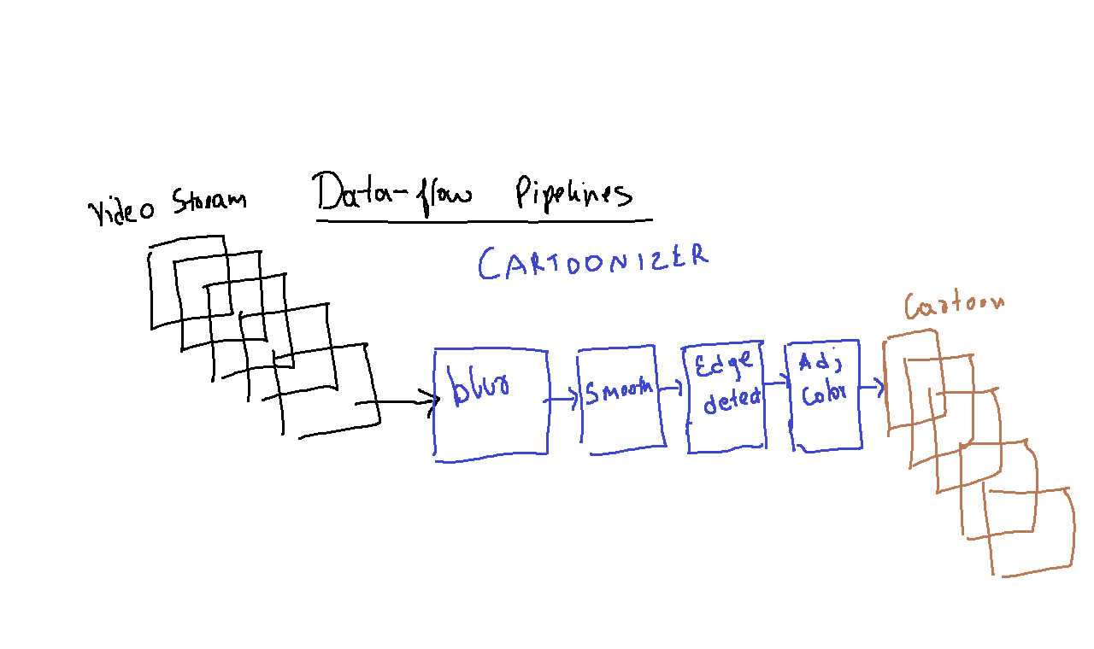
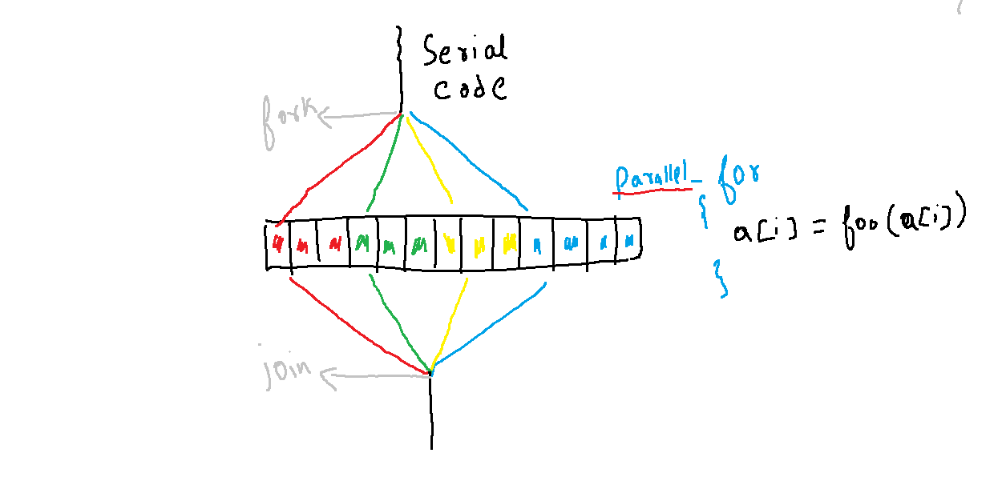
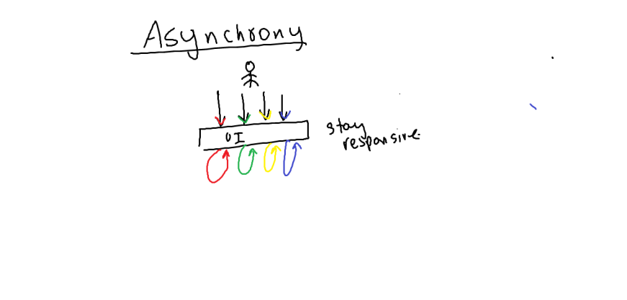
Data Flow
Fork-Join
Asynchrony

Slide 4
Data Flow
Fork-Join
Asynchrony

Slide 12
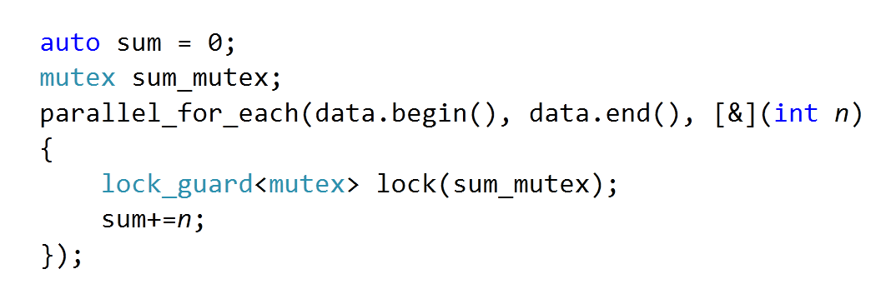

Slide 14
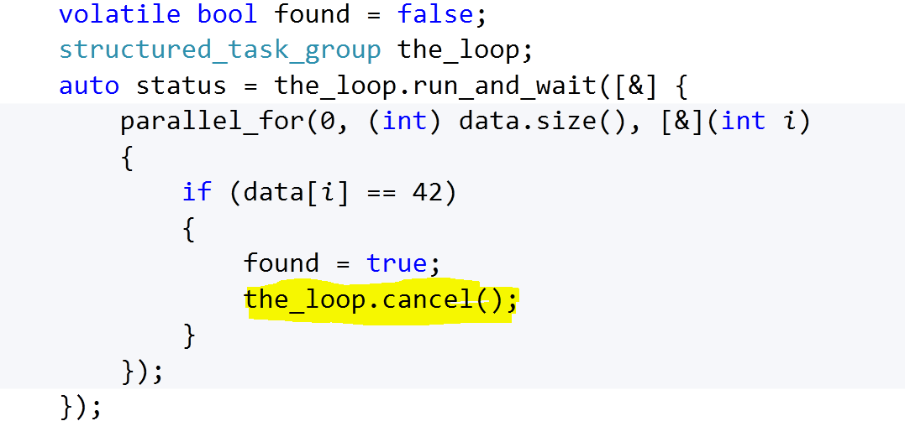

Slide 17
Fork-Join
Constructs
parallel_for
parallel_for_each
parallel_invoke
parallel_for fixed
parallel_for simple
parallel_transform
parallel_reduce
parallel_sort
parallel_radixsort
parallel_buffered_sort
task_group
.run(), .wait(), .cancel(), .run_and_wait()
Patterns
Data Parallel
Reduction
Cancelation
Nested fork-join
Recursive fork-join

Slide 18
Data Flow
Fork-Join
Asynchrony

Slide 20
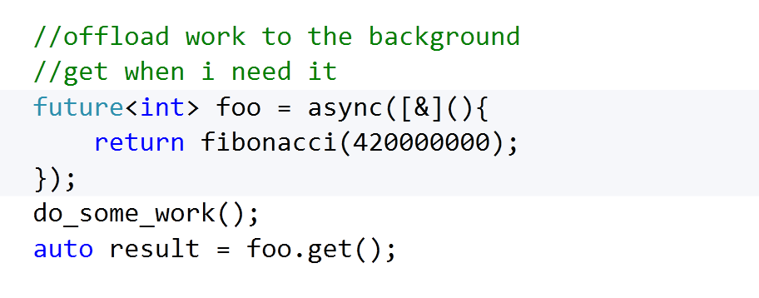
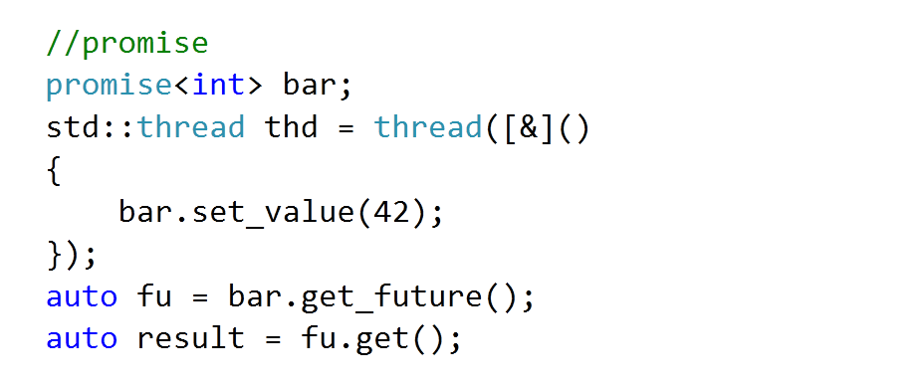

Slide 21
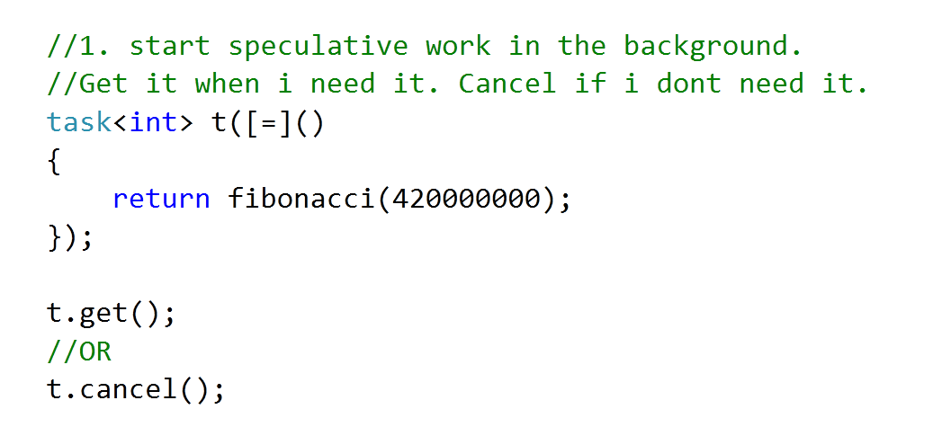

Slide 23
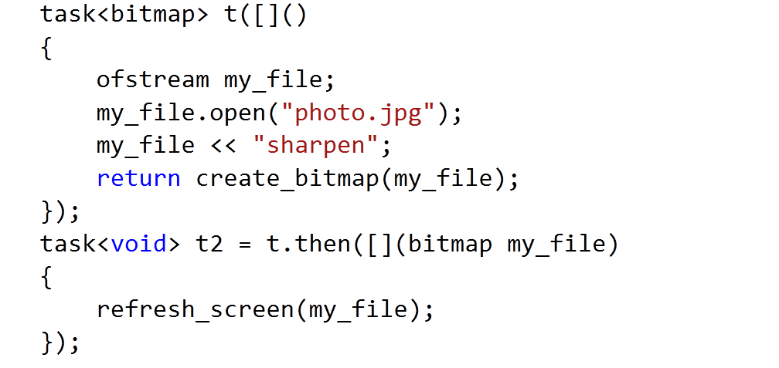

Slide 26
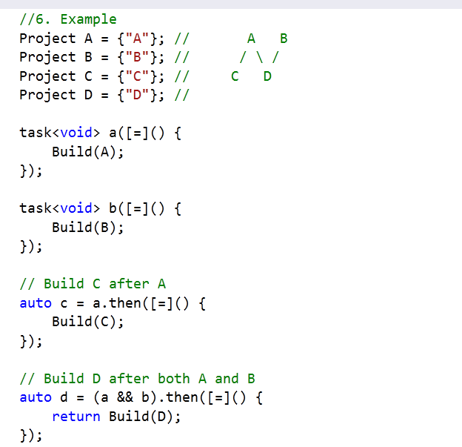

Slide 27
Asynchrony
Constructs
std::future<t>
std::async, std::promise<t>
task<t>
.then,
.wait,
.get,
.cancel
when_all,
when_any
task_completion_event<t>
.set
Patterns
Speculative background work
If you block, you break
Dynamic continuation graphs

Slide 28
Data Flow
Fork-Join
Asynchrony

Slide 30
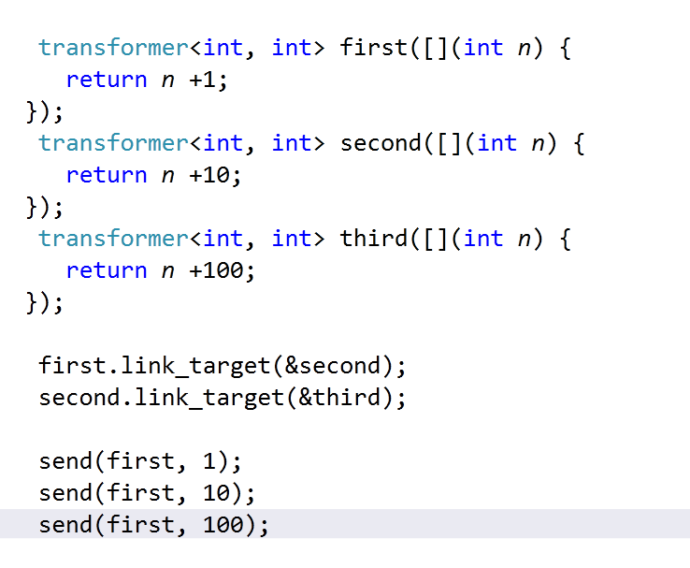

Slide 31
Data Flow
Constructs
Blocks and operations
call<t>
transformer<t>
join, multitype_join<…>
choice<…>
unbounded_buffer
overwrite_buffer
single_assignment
timer
Patterns
Producer-Consumer
Pipelines

Slide 32
Recap
Fork-Join
Sequential code that needs to go faster
Well defined input, transformation and output
Async
If you block you break
Speculative background work
Reactive
Continuations
Data-Flow
Either transformative or reactive
Natural to express computation in phases
Streaming inputs
Order matters

Slide 33
Infrastructure
Composable
Scalable
Efficient

Slide 34
Conccurrent Data Structures
concurrent_vector<t>
concurrent_queue<t>
concurrent_unordered_map<key,t>
concurrent_unordered_multimap<key,t>
concurrent_unordered_set<key,t>
concurrent_unordered_multiset<key,t>
concurrent_priority_queue<t>

Slide 35
Tooling

Slide 36
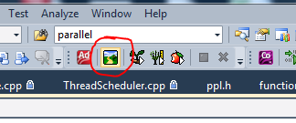
Intel Advisor

Slide 37
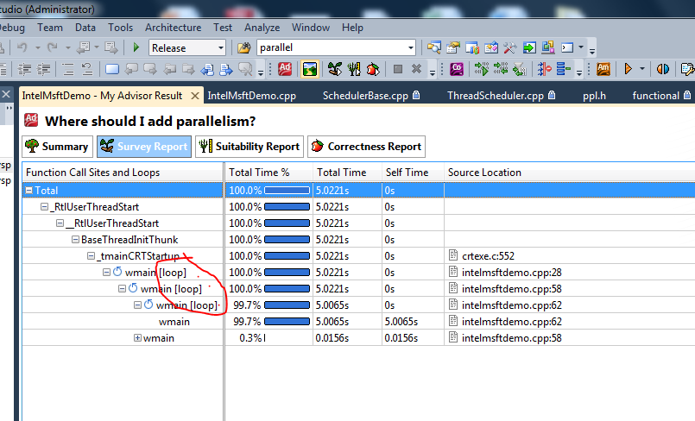
Identify hot loops

Slide 38
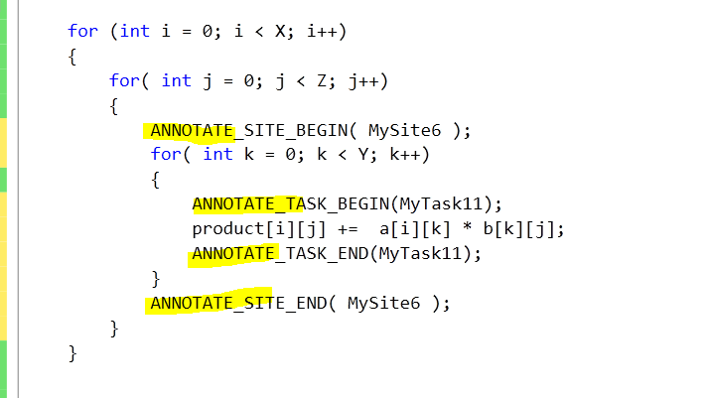

Slide 39
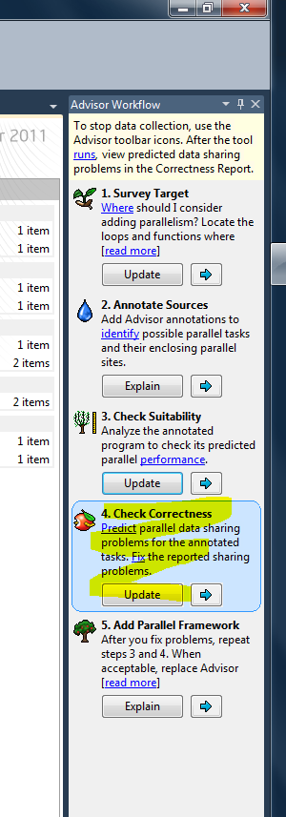
Intel correctness tool
Identify Write race when parallelizing inner loop

Slide 40
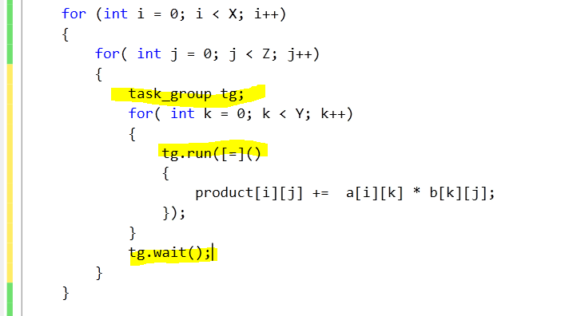
Add PPL tasks code

Slide 41
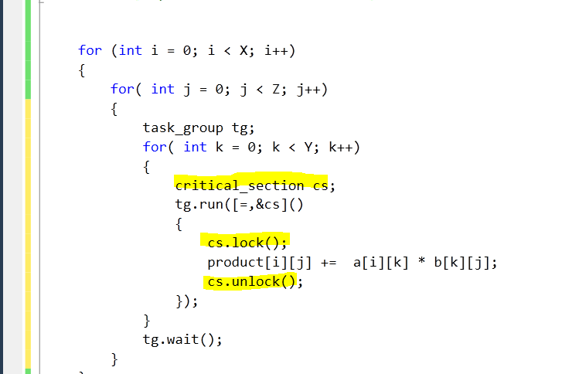
Add Synchronization

Slide 42
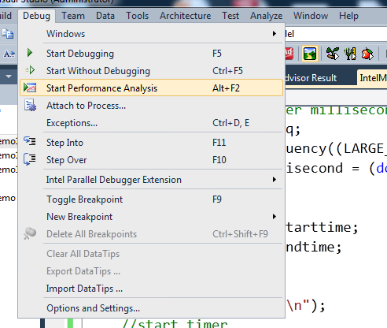
Launch Concurrency Visualizer

Slide 43
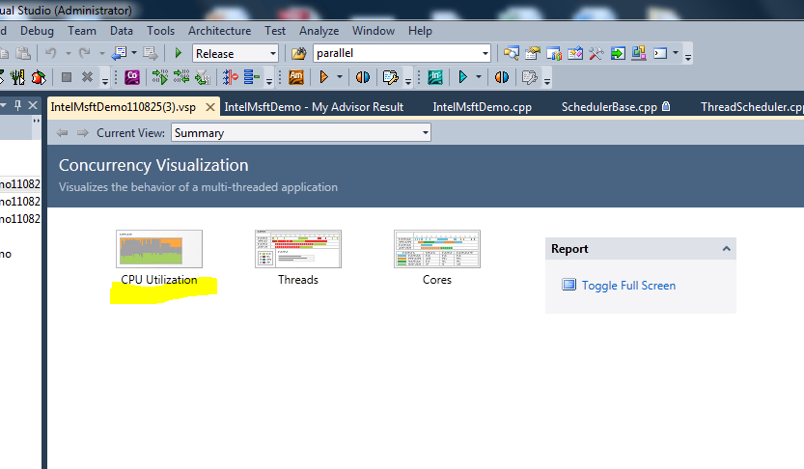

Slide 44
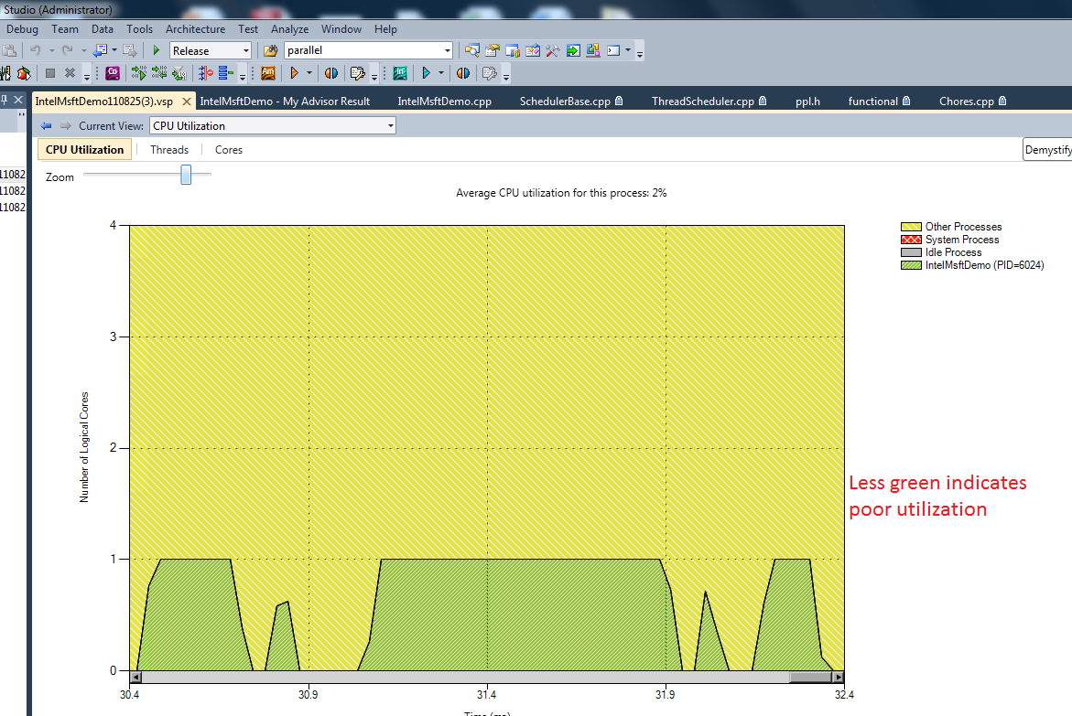

Slide 45
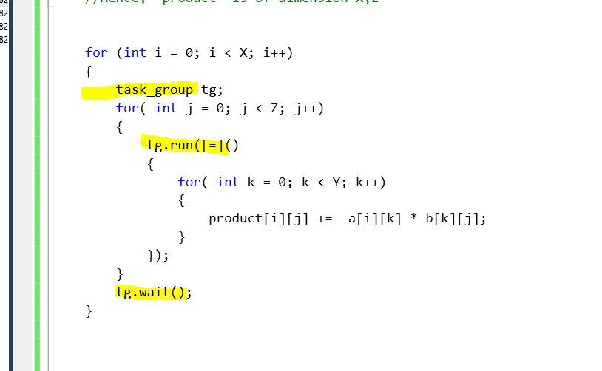
Add parallelism to middle loop

Slide 46
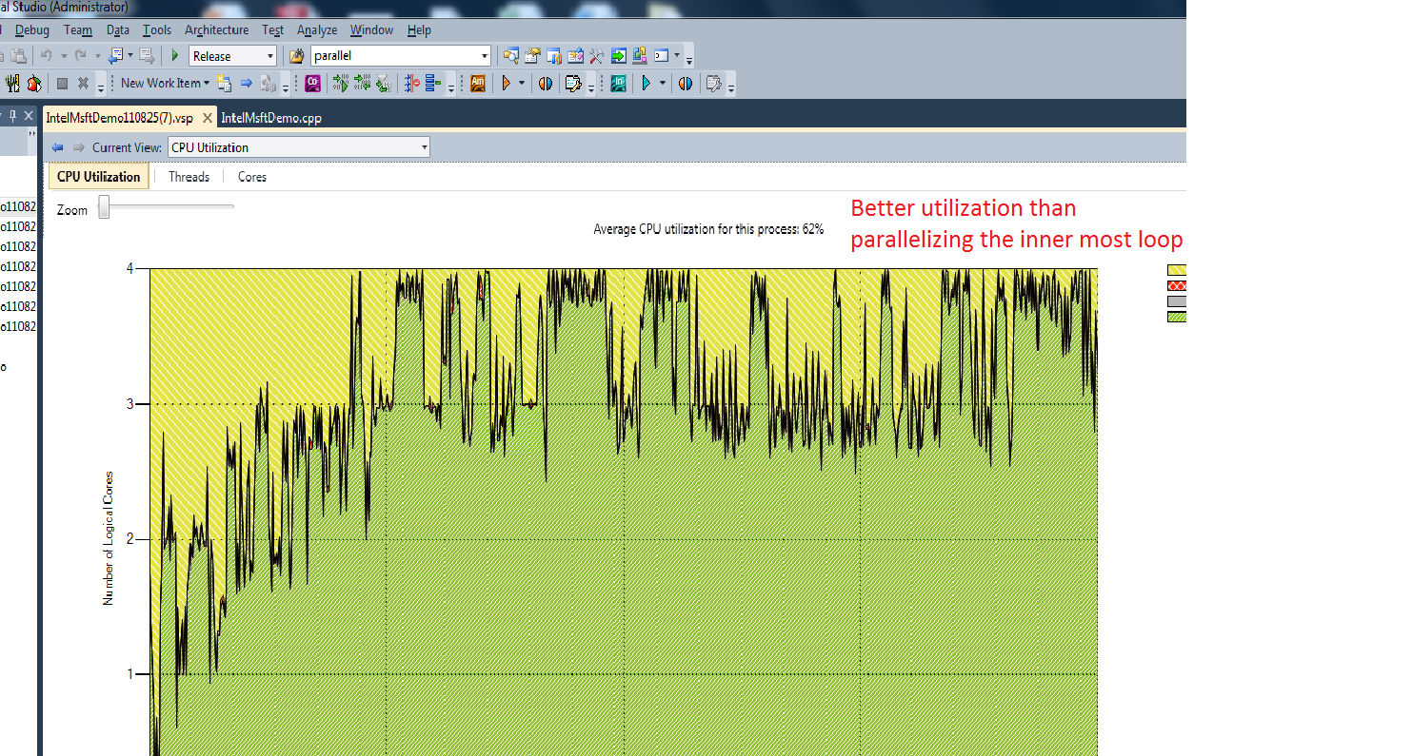

Slide 47
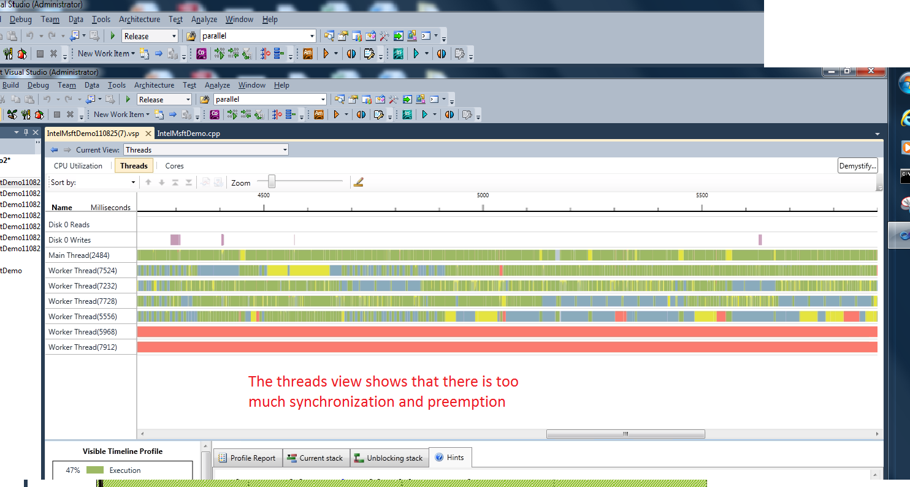

Slide 48
Q&A
Blog Posts: C++ PPL and AMP blog
Questions on PPL: Native parallelism forum
Email me at:
[r_ a_ h_ u_ l d o t p_ a_ t_ i_ l a t m_ i_ c_ r_ o_ s_ o_ f_ t_ . c_ o_ m (delete all underscores and spaces; replace d o t with the character ".“; at with @ ).]

