Slide 1
Harnessing GPU compute with C++ Accelerated Massive Parallelism
Don J. McCrady
Principal Development Lead
Developer Division
Microsoft Corporation

Slide 2
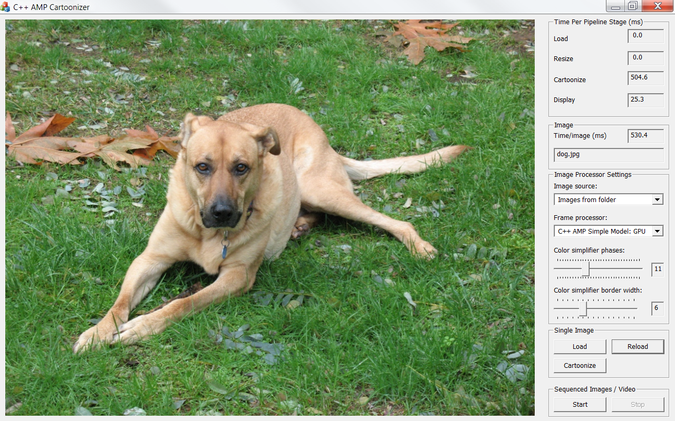
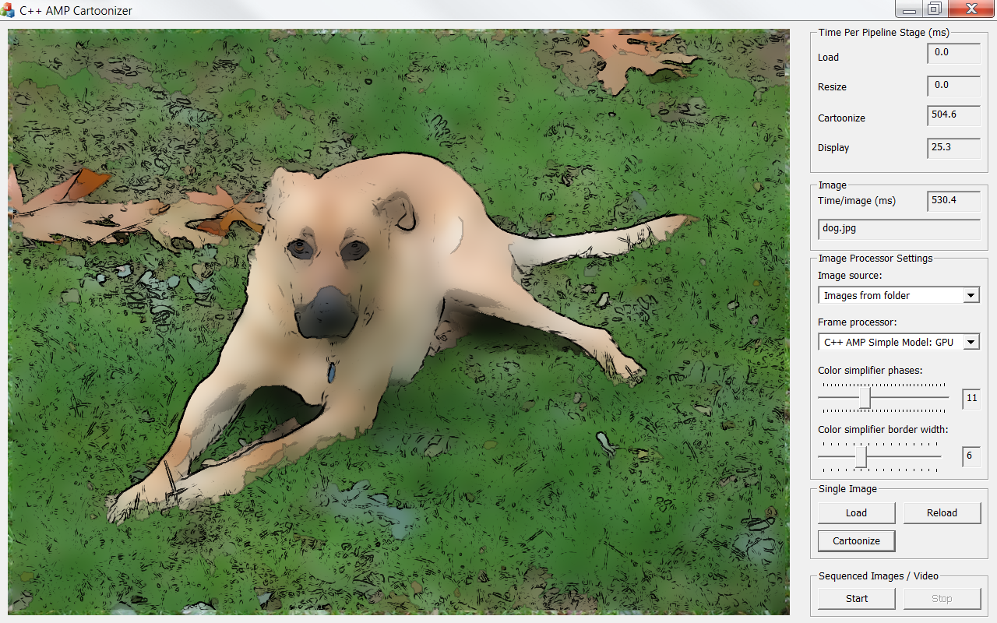
Cartoonizer

Slide 3
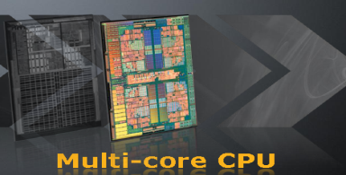
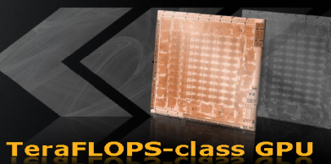
GPU Computing today…
CPU
GPU
Low memory bandwidth
Higher power consumption
Medium level of parallelism
Deep execution pipelines
Random accesses
Supports general code
Mainstream programming
High memory bandwidth
Lower power consumption
High level of parallelism
Shallow execution pipelines
Sequential accesses
Supports data-parallel code
Niche programming
images source: AMD

Slide 4
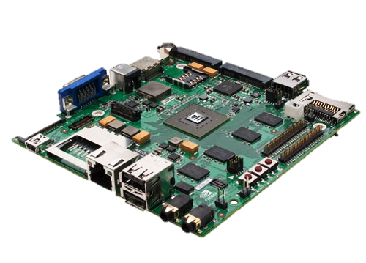
…tomorrow…
CPUs and GPUs coming closer together…
…nothing settled in this space, things still in motion…
C++ AMP is designed as a mainstream solution not only for today, but also for tomorrow
image source: NVIDIA

Slide 5
C++ AMP
Part of Visual C++
Visual Studio integration
STL-like library for multidimensional data
Builds on Direct3D
An open specification
performance
productivity
portability

Slide 6
C++ AMP at a Glance
restrict(amp)
parallel_for_each
class accelerator_view
class accelerator
class extent<N>
class index<N>
class array_view<T,N>
class array<T,N>

Slide 7
extent<N> and index<N>
index<N> - an N-dimensional point
extent<N> - # of units in each dimension of an N-dim space
rank N can be any number <=128
index<1> i(2);
index<2> i(0,2);
index<3> i(2,0,1);
extent<1> e(6);
extent<2> e(3,4);
extent<3> e(3,2,2);
http://www.danielmoth.com/Blog/concurrencyindex-From-Amph.aspx
http://www.danielmoth.com/Blog/concurrencyextent-From-Amph.aspx

Slide 8
parallel_for_each
Executes the kernel for each point in the extent
As-if synchronous in terms of visible side-effects
parallel_for_each(
e, //e is of type extent<N>
[ ](index<N> idx) restrict(amp)
{
// kernel code
}
);
http://www.danielmoth.com/Blog/parallelforeach-From-Amph-Part-1.aspx

Slide 9
array<T,N>
Multi-dimensional array of rank N with element T
Container whose storage lives on a specific accelerator
Capture by reference [&] in the lambda
Explicit copy
Nearly identical interface to array_view<T,N>
vector<int> v(8 * 12);
extent<2> e(8,12);
array<int,2> a(e);
copy_async(v.begin(), v.end(), a);
parallel_for_each(e, [&a](index<2> idx) restrict(amp)
{
a[idx] += 1;
});
copy(a, v.begin());
http://www.danielmoth.com/Blog/array-And-Arrayview-From-Amph.aspx

Slide 10
array_view<T,N>
View on existing data on the CPU or GPU
Rectangular, contiguous
Of element T and rank N
Indexing identical to array
Access anywhere (implicit sync)
vector<int> v(10);
extent<2> e(2,5);
array_view<int,2> a(e, v);
index<2> idx(1,3);
int obj = a[idx]; // or a[idx] = 16;
//or int obj = a(1, 3);
//above two lines can also be written
//array_view<int,2> a(2,5,v);
http://www.danielmoth.com/Blog/array-And-Arrayview-From-Amph.aspx

Slide 11
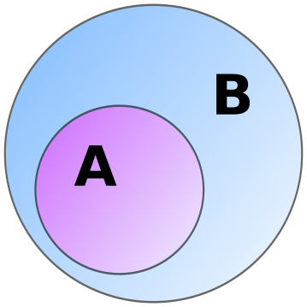
restrict( . . . )
Applies to functions (including lambdas)
restrict(…) informs the compiler to enforce language restrictions
e.g., target-specific restrictions, optimizations, special code-gen
In 1st release we are only implementing two options
cpu – the implicit default
amp – checks that the function conforms to C++ AMP restrictions
http://blogs.msdn.com/b/nativeconcurrency/archive/2011/09/05/restrict-a-key-new-language-feature-introduced-with-c-amp.aspx

Slide 12
restrict(amp) restrictions
Can only call other restrict(amp) functions
All functions must be inlinable
Only amp-supported types
int, unsigned int, float, double
structs & arrays of these types
Pointers and References
Lambdas cannot capture by reference¹, nor capture pointers
References and single-indirection pointers supported only as local variables and function arguments

Slide 13
restrict(amp) restrictions
No
recursion
'volatile'
virtual functions
pointers to functions
pointers to member functions
pointers in structs
pointers to pointers
bitfields
No
goto or labeled statements
throw, try, catch
globals or statics
dynamic_cast or typeid
asm declarations
varargs
unsupported types
e.g. char, short, long double
http://blogs.msdn.com/b/nativeconcurrency/archive/2011/12/19/restrict-amp-restrictions-part-0-of-n-introduction.aspx

Slide 14
Example: restrict overloading
double cos( double d ); // 1a: cpu code
double cos( double d ) restrict(amp); // 1b: amp code
double bar( double d ) restrict(cpu,amp); // 2 : common subset of both
void some_method(array_view<double,2>& c) {
parallel_for_each( c.extent, [=](index<2> idx) restrict(amp)
{
//…
double d0 = c[idx];
double d1 = bar(d0); // ok, bar restrictions include amp
double d2 = cos(d0); // ok, chooses amp overload
//…
});
}

Slide 15
Test: Matrix Multiplication (part 1)
void MatrixMultiplySerial( vector<float>& vC,
const vector<float>& vA,
const vector<float>& vB, int M, int N, int W )
{
for (int row = 0; row < M; row++) {
for (int col = 0; col < N; col++){
float sum = 0.0f;
for(int i = 0; i < W; i++)
sum += vA[row * W + i] * vB[i * N + col];
vC[row * N + col] = sum;
}
}
}
void MatrixMultiply2D( vector<float>& vC,
const vector<float>& vA,
const vector<float>& vB, int M, int N, int W )
{
array_view<const float,2> a(M,W,vA),b(W,N,vB);
array_view<float,2> c(M,N,vC);
for (int row = 0; row < M; row++) {
for (int col = 0; col < N; col++){
float sum = 0.0f;
for(int i = 0; i < W; i++)
sum += a(row, i) * b(i, col);
c(row,col) = sum;
}
}
}

Slide 16
Test: Matrix Multiplication (part 2)
void MatrixMultiply2D( vector<float>& vC,
const vector<float>& vA,
const vector<float>& vB, int M, int N, int W )
{
array_view<const float,2> a(M,W,vA),b(W,N,vB);
array_view<float,2> c(M,N,vC);
for (int row = 0; row < M; row++) {
for (int col = 0; col < N; col++){
float sum = 0.0f;
for(int i = 0; i < W; i++)
sum += a(row, i) * b(i, col);
c(row,col) = sum;
}
}
}
void MatrixMultiplyAMP( vector<float>& vC,
const vector<float>& vA,
const vector<float>& vB, int M, int N, int W )
{
array_view<const float,2> a(M,W,vA),b(W,N,vB);
array_view<float,2> c(M,N,vC);
c.discard_data();
parallel_for_each(c.extent,
[=](index<2> idx) restrict(amp) {
int row = idx[0]; int col = idx[1];
float sum = 0.0f;
for(int i = 0; i < W; i++)
sum += a(row, i) * b(i, col);
c(row,col) = sum; // or c[idx] = sum;
}
);
}

Slide 17
<amp_math.h>
#include <amp.h>
#include <amp_math.h>
using namespace concurrency;
using namespace concurrency::fast_math;
// using namespace concurrency::precise_math;
int main() {
float a = 2.2f, b = 3.5f;
float result = pow(a,b);
std::vector<float> v(1);
array_view<float> av(1,v);
parallel_for_each(av.extent, [=](index<1> idx) restrict(amp)
{
av[idx] = pow(a,b);
});
}
concurrency::fast_math
Wrap Direct3D intrinsics
35 functions
Single-precision only
Sacrifice accuracy for speed
concurrency::precise_math
68 C99 functions
Require full double precision
even for single precision functions
http://blogs.msdn.com/b/nativeconcurrency/archive/2012/02/08/math-library-for-c-amp.aspx

Slide 18
Thread tiles and tile_static memory
…
…
tile of threads
…
…
…
…
…
…
Programmable Cache
Programmable Cache
tile_static variables shared by threads in the same tile
Global Memory
Not showing:
Constant memory
Memory controllers
Registers
Other caches
Multi-GPU case

Slide 19
parallel_for_each: tiled overload
array_view<int,1> data(12, my_data);
parallel_for_each(data.extent,
[=] (index<1> idx) restrict(amp)
{ … });
Schedule threads in tiles
Gain ability to use tile static memory
parallel_for_each overload for tiles accepts
tiled_extent<D0> or tiled_extent<D0, D1> or tiled_extent<D0, D1, D2>
a lambda which accepts
tiled_index<D0> or tiled_index<D0, D1> or tiled_index<D0, D1, D2>
parallel_for_each(data.extent.tile<6>(),
[=] (tiled_index<6> t_idx) restrict(amp)
{ … });

Slide 20
tiled_index
Given
When the lambda is executed by
t_idx.global // index<2> (1,3)
t_idx.local // index<2> (1,1)
t_idx.tile // index<2> (0,1)
t_idx.tile_origin // index<2> (0,2)
array_view<int,2> data(2, 6, p_my_data);
parallel_for_each(
data.extent.tile<2,2>(),
[=] (tiled_index<2,2> t_idx)… { … });
T
T

Slide 21
Example: Matrix Multiplication (tiled)
void MatrixMultiplyAMP(vector<float>& vC, const vector<float>& vA, const vector<float>& vB, int M, int N, int W )
{
array_view<const float,2> a(M,W,vA),b(W,N,vB);
array_view<float,2> c(M,N,vC); c.discard_data();
parallel_for_each(c.extent,
[=](index<2> idx) restrict(amp) {
int row = idx[0]; int col = idx[1];
float sum = 0.0f;
for(int i = 0; i < W; i++)
sum += a(row, i) * b(i, col);
c[idx] = sum;
} );
}
void MatrixMultTiled(vector<float>& vC, const vector<float>& vA, const vector<float>& vB, int M, int N, int W )
{
static const int TS = 16;
array_view<const float,2> a(M, W, vA), b(W, N, vB);
array_view<float,2> c(M,N,vC); c.discard_data();
parallel_for_each(c.extent.tile< TS, TS >(),
[=] (tiled_index< TS, TS> t_idx) restrict(amp) {
tile_static float locA[TS][TS], locB[TS][TS];
int row = t_idx.local[0]; int col = t_idx.local[1];
float sum = 0.0f;
for (int i = 0; i < W; i += TS) {
locA[row][col] = a(t_idx.global[0], col + i);
locB[row][col] = b(row + i, t_idx.global[1]);
t_idx.barrier.wait();
for (int k = 0; k < TS; k++)
sum += locA[row][k] * locB[k][col];
t_idx.barrier.wait();
}
c[t_idx.global] = sum;
} );
}
Phase 1
Phase 2

Slide 22
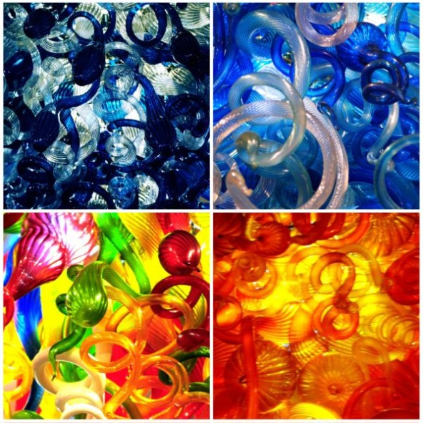
<amp_graphics.h>, concurrency::graphics
norm/unorm scalar type
Short vector types (int_3, float_4, norm_2, etc.)
Swizzle expressions: myvec.yzx = int_3(1, 2, 3);
Textures – efficient access to 1d, 2d, 3d data
Element type is scalar or SVT of rank 1, 2 or 4
DX limitations apply
Different encodings supported
Interop with DX texture resources
http://blogs.msdn.com/b/nativeconcurrency/archive/2012/01/25/concurrency-graphics-in-c-amp.aspx

Slide 23
Learn C++ AMP
book http://www.gregcons.com/cppamp/
training http://www.acceleware.com/cpp-amp-training
videos http://channel9.msdn.com/Tags/c++-accelerated-massive-parallelism
articles http://blogs.msdn.com/b/nativeconcurrency/archive/2012/04/05/c-amp-articles-in-msdn-magazine-april-issue.aspx
samples http://blogs.msdn.com/b/nativeconcurrency/archive/2012/01/30/c-amp-sample-projects-for-download.aspx
guides http://blogs.msdn.com/b/nativeconcurrency/archive/2012/04/11/c-amp-for-the-cuda-programmer.aspx
spec http://blogs.msdn.com/b/nativeconcurrency/archive/2012/02/03/c-amp-open-spec-published.aspx
forum http://social.msdn.microsoft.com/Forums/en/parallelcppnative/threads
http://blogs.msdn.com/nativeconcurrency/

Slide 24
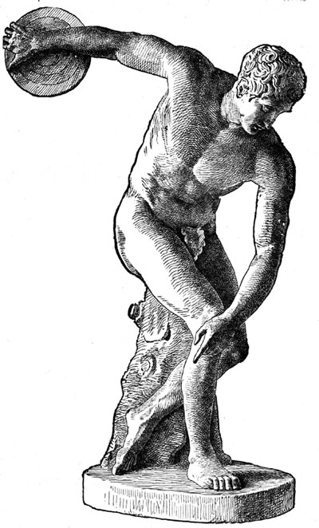
Summary
Democratization of parallel hardware programmability
Performance for the mainstream
High-level abstractions in modern C++ (not C)
Future proof, minimal, data-parallel API
State-of-the-art Visual Studio IDE
Hardware abstraction platform
An open specification

Slide 25
© 2011 Microsoft Corporation. All rights reserved. Microsoft, Windows, Windows Vista and other product names are or may be registered trademarks and/or trademarks in the U.S. and/or other countries.
The information herein is for informational purposes only and represents the current view of Microsoft Corporation as of the date of this presentation. Because Microsoft must respond to changing market conditions, it should not be interpreted to be a commitment on the part of Microsoft, and Microsoft cannot guarantee the accuracy of any information provided after the date of this presentation. MICROSOFT MAKES NO WARRANTIES, EXPRESS, IMPLIED OR STATUTORY, AS TO THE INFORMATION IN THIS PRESENTATION.

